Slide 1
School of Education
INDIANA UNIVERSITY
Spring Faculty Meeting
Friday, March 29, 2019

Slide 2
Agenda
Welcome Dean Watson
Dean’s Update Dean Watson
Other Updates Faculty
Lunch Atrium Balcony
___________________________________________________
All-School Meeting • Friday, April 26 • 10am - Noon

Slide 3
Assumptions
I don’t have a set of preconceived outcomes of how or what needs to be done other than what has been shared with me as a dean.
My role is to ask questions, facilitate, lead, and coordinate groups and resources to make sure the work gets done.

Slide 4
Assumptions
I am responsible to make sure we are accountable for our resources.
I believe that each person is an adult and will act accordingly, so I am not “making” anyone do anything.

Slide 5
Assumptions
To make sure you understand the short and long term consequences of our decisions.
To make sure that I am legally and authoritatively honoring the terms of my contract with Indiana University, Board of Trustees, and the State of Indiana as I serve the School of Education.

Slide 6
Mission Statement and Values
The mission of the Indiana University School of Education is to improve teaching, learning, and human development in a global, diverse, rapidly changing, and increasingly technological society.
We:
Prepare reflective, caring, and highly skilled educational practitioners and scholars who lead in their chosen professions;
Inform educational theory and practice through research; and
Work in partnership with a range of constituents to effect change from the local to national levels and throughout the world.

Slide 7
Core Values
As a leader in anticipating and serving the educational and research needs of our communities, the state, the nation, and the world, the Indiana University School of Education pursues cutting-edge research, scholarship, and creative activity.
In this work, the School promotes:
Excellence
Integrity
Diversity
Accountability
Usefulness
Respect

Slide 8
Goals
Prepare excellent teachers and offer high quality undergraduate and graduate education more broadly as the essential priority in the School of Education.
Engage in collaborative partnerships with P-12 schools and student-centered agencies.
Illuminate and improve educational theory and practice, and prepare tomorrow’s leaders in the field through rigorous, innovative research and professional education.
Exemplify and provide leadership in the appropriate use of technologies to enhance teaching, research, and learning experiences.
Create a diverse and inclusive environment for learning, research, and service by honoring, respecting, and embracing diversity within the School of Education and the surrounding communities.

Slide 9
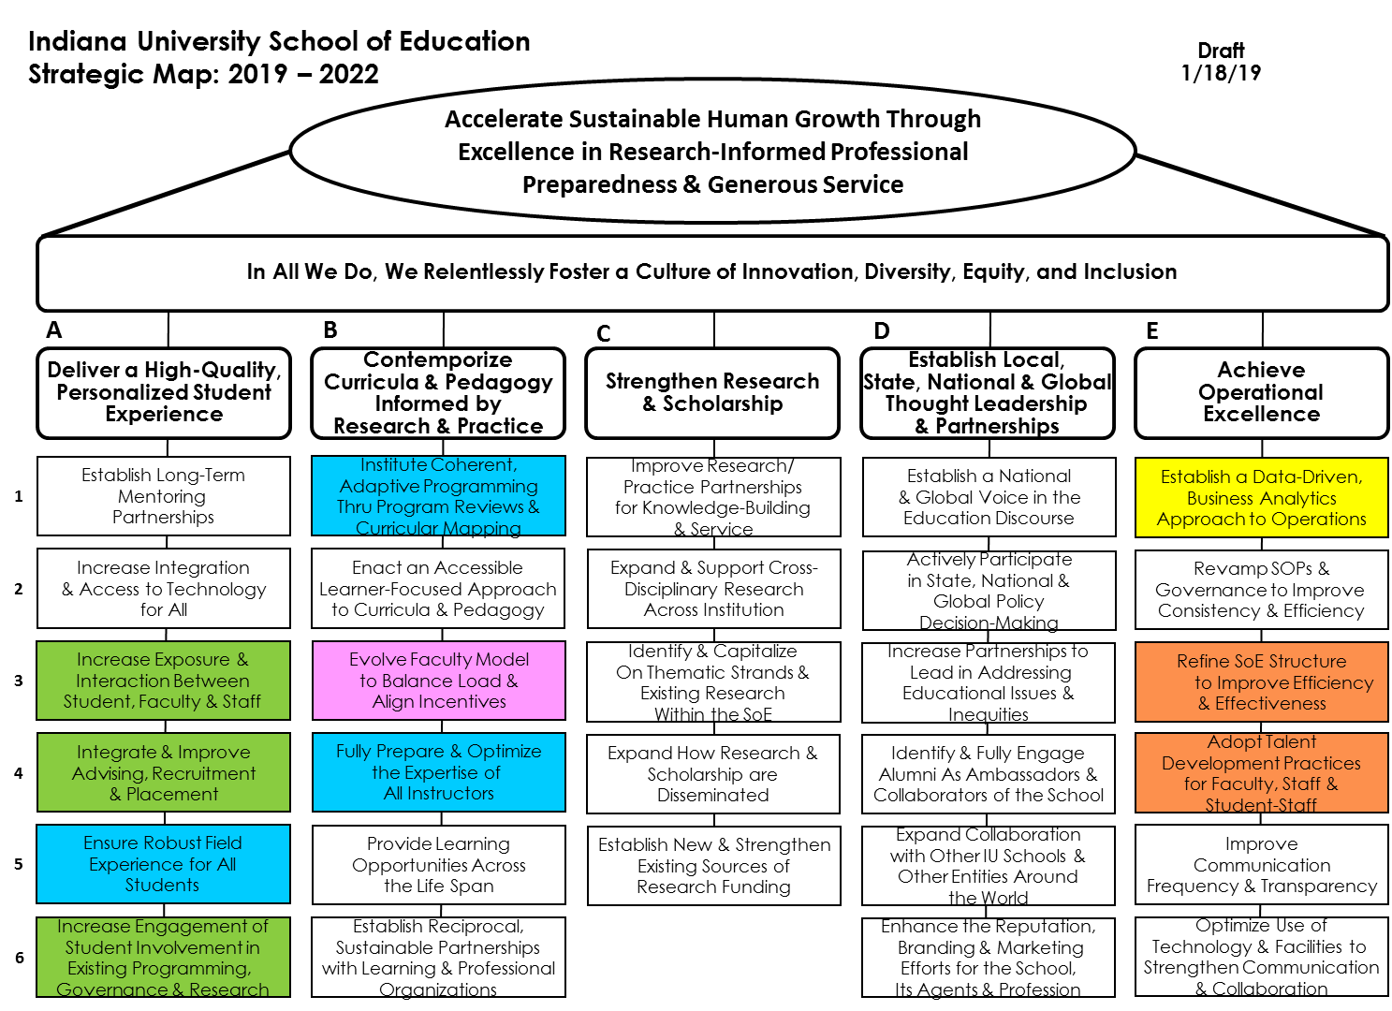
Strategic Initiatives and Priorities (short-term)

Slide 10
Indiana University School of Education
Strategic Map: 2019 – 2022
Draft
1/18/19
Accelerate Sustainable Human Growth Through
Excellence in Research-Informed Professional
Preparedness & Generous Service
In All We Do, We Relentlessly Foster a Culture of Innovation, Diversity, Equity, and Inclusion
A
B
C
D
E
Deliver a High-Quality,
Personalized Student
Experience
Contemporize
Curricula & Pedagogy
Informed by
Research & Practice
Strengthen Research
& Scholarship
Establish Local,
State, National & Global
Thought Leadership
& Partnerships
Achieve
Operational
Excellence
Establish Long-Term
Mentoring
Partnerships
Institute Coherent,
Adaptive Programming
Thru Program Reviews &
Curricular Mapping
Improve Research/
Practice Partnerships
for Knowledge-Building
& Service
Establish a National
& Global Voice in the
Education Discourse
Establish a Data-Driven,
Business Analytics
Approach to Operations
1
Increase Integration
& Access to Technology
for All
Enact an Accessible
Learner-Focused Approach
to Curricula & Pedagogy
Expand & Support Cross-
Disciplinary Research
Across Institution
Actively Participate
in State, National &
Global Policy
Decision-Making
Revamp SOPs &
Governance to Improve
Consistency & Efficiency
2
Increase Exposure &
Interaction Between
Student, Faculty & Staff
Evolve Faculty Model
to Balance Load &
Align Incentives
Identify & Capitalize
On Thematic Strands &
Existing Research
Within the SoE
Increase Partnerships to
Lead in Addressing
Educational Issues &
Inequities
Refine SoE Structure
to Improve Efficiency
& Effectiveness
3
Integrate & Improve
Advising, Recruitment
& Placement
Fully Prepare & Optimize
the Expertise of
All Instructors
Expand How Research &
Scholarship are
Disseminated
Identify & Fully Engage
Alumni As Ambassadors &
Collaborators of the School
Adopt Talent
Development Practices
for Faculty, Staff &
Student-Staff
4
Ensure Robust Field
Experience for All
Students
Provide Learning
Opportunities Across
the Life Span
Establish New & Strengthen
Existing Sources of
Research Funding
Expand Collaboration
with Other IU Schools &
Other Entities Around
the World
Improve
Communication
Frequency & Transparency
5
Increase Engagement of
Student Involvement in
Existing Programming,
Governance & Research
Establish Reciprocal,
Sustainable Partnerships
with Learning & Professional
Organizations
Enhance the Reputation,
Branding & Marketing
Efforts for the School,
Its Agents & Profession
Optimize Use of
Technology & Facilities to
Strengthen Communication
& Collaboration
6
Notes:
The fifth track of work – highlighted in orange – is Enhance Talent Management. It includes Strategic Objectives E-3 and E-4.
As we move forward with implementing the strategic map, these five areas will receive priority for the first twelve months.

Slide 11
Opportunities & Challenges
Dean’s Job Announcement
Define a distinctive identity for the School, one which incorporates scholarly excellence, service, and global presence into a cohesive vision for the future.
Innovate to grow enrollment, attract top undergraduate and graduate students, and ensure long-term sustainability.

Slide 12
Opportunities & Challenges
Dean’s Job Announcement
Assess and refine the School’s infrastructure to enhance support for students, cultivate faculty, and encourage collaboration across departments and programs.
Forge strong relationships with partners across campus and the educational community in Indiana and beyond.

Slide 13
Opportunities & Challenges
Dean’s Job Announcement
Manage a complex enterprise and grow the financial resources of the School.
Advance commitment to diversity, inclusion, and social justice of the School.

Slide 14
Getting There
I have already begun to move on those things for which the Dean’s Office has direct responsibility.
Retreat scheduled for May - in conjunction with Long-Range Planning Committee – to identify the scope of work and who will be responsible for what.
We will be working over the summer to get ready for the SoE Faculty Retreat (Date TBD) to share work to be done.

Slide 15
Updates to Dean’s Office Suite
Reporting roles
Permanent terms for current interims
Closed search for Associate Dean for Diversity, Equity, and Inclusion and re-evaluating role at IU and scope of work to be done in the SoE
Hiring
Center (Research Centers, Service Centers, and Institutes)

Slide 16
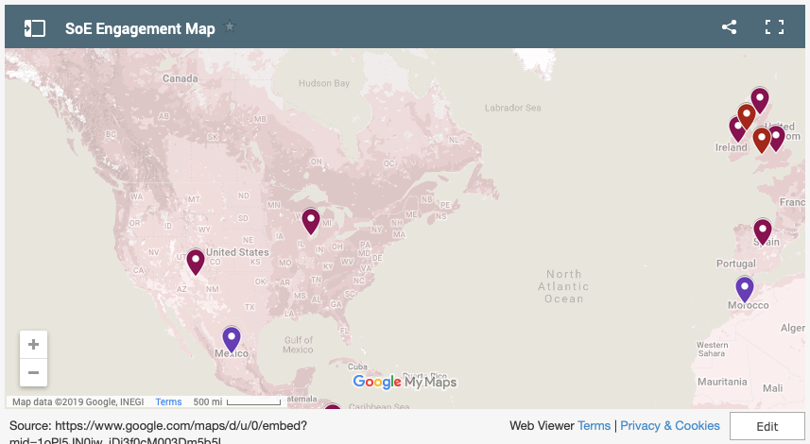

Slide 17
Update on International Visits from the Year
Turkey
Thailand
Kosovo
Ethiopia

Slide 18
Themes for requests
Special education
Science and technology
Leadership and management
Enhancement of teacher education and systemic changes for P-20 education
Experienced practitioners who also have research and policy knowledge to help with transformation . . . .

Slide 19
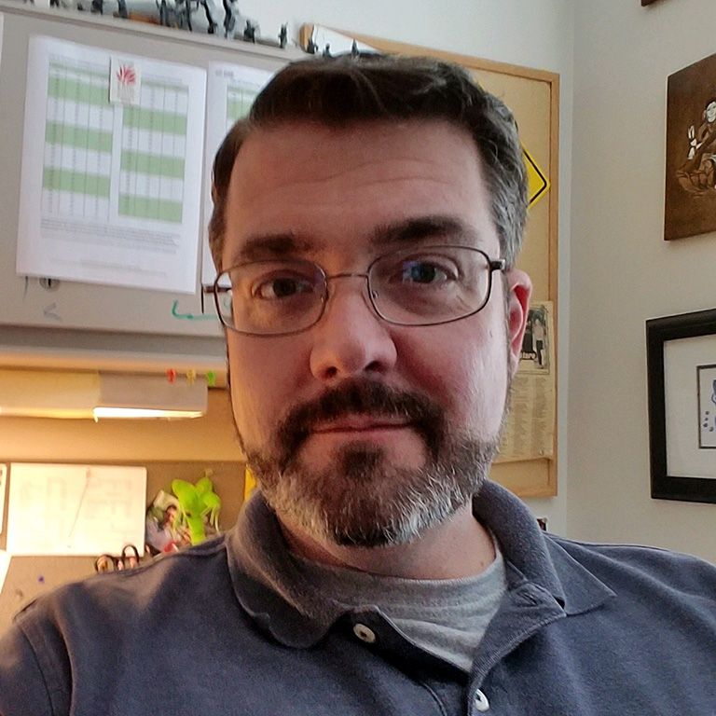
In Memoriam
David Estell Associate Professor Department of Counseling and Educational Psychology Human Development, School Psychology
June 29, 1973 – February 19, 2019

Slide 20
Where our funding goes

Slide 21
Where our funding comes from

Slide 22
General Fund Trends

Slide 23
Spring 2019 Course Enrollment Table
Department | Undergrad Sections Offered | Undergrad Sections Under Enrolled | % Under enrolled | Graduate Sections Offered | Graduate Sections Under Enrolled | % Under enrolled
C&I | 109 | 38 | 35% | 51 | 26 | 51%
CEP | 41 | 7 | 17% | 78 | 19 | 24%
ELPS | 43 | 2 | 5% | 52 | 8 | 15%
IST | 12 | 5 | 42% | 28 | 10 | 36%
LCLE | 21 | 12 | 57% | 35 | 8 | 23%
School-wide totals | 226 | 64 | 29% | 244 | 71 | 29%
Co-taught sections are counted as one
Sections with 0 Spring enrollment are not counted
Sections that do not count toward teaching load (e.g., independent studies) are included in the number of sections offered but not as under-enrolled

Slide 24
Who Teaches Under Enrolled Sections?
 | Faculty |  | AI |  | Other
Department | # | % | # | % | # | %
C&I | 35 | 55% | 19 | 30% | 10 | 15%
CEP | 18 | 69% | 7 | 27% | 1 | 4%
ELPS | 8 | 80% | 1 | 10% | 1 | 10%
IST | 11 | 73% | 3 | 20% | 1 | 7%
LCLE | 11 | 52% | 6 | 29% | 4 | 19%
School-wide totals | 83 | 61% | 36 | 27% | 17 | 12%

Slide 25
Sponsored Research Trends
 | FY 2014 | FY 2015 | FY 2016 | FY 2017 | FY 2018 | FY 2019 (July - February)
Proposal Numbers | 121 | 112 | 116 | 150 | 132 | 46
Proposal Dollars | $41,318,410 | $50,600,487 | $46,813,653 | $65,209,506 | $62,524,113 | $23,118,353
Award Numbers | 63 | 62 | 67 | 76 | 56 | 35
Award Dollars | $8,322,828 | $10,542,550 | $11,087,241 | $7,013,361 | $9,821,041 | $5,913,867
Indirect Dollars | $1,496,746 | $1,404,003 | $1,316,966 | $1,141,643 | $1,217,689 | $1,594,135

Slide 26
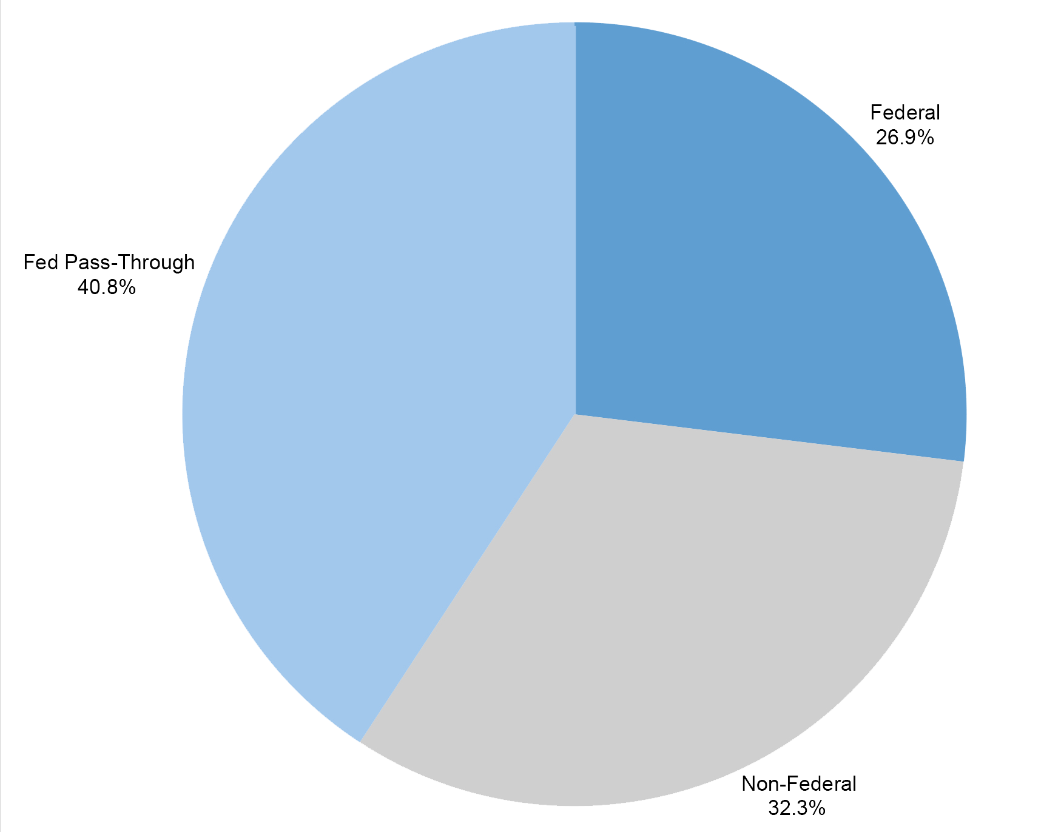
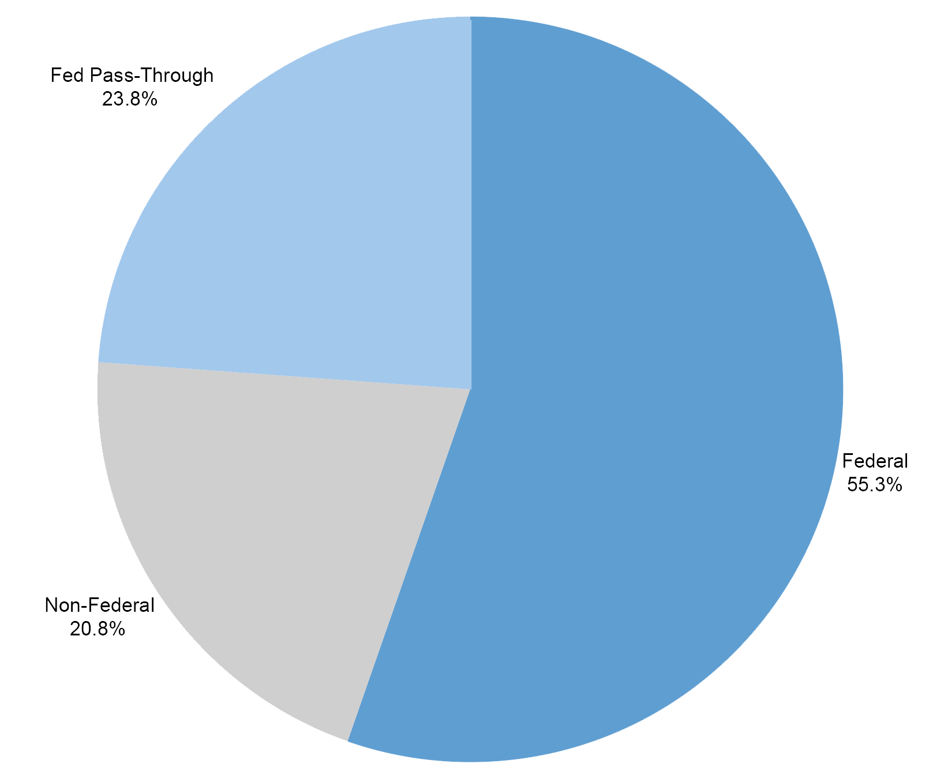
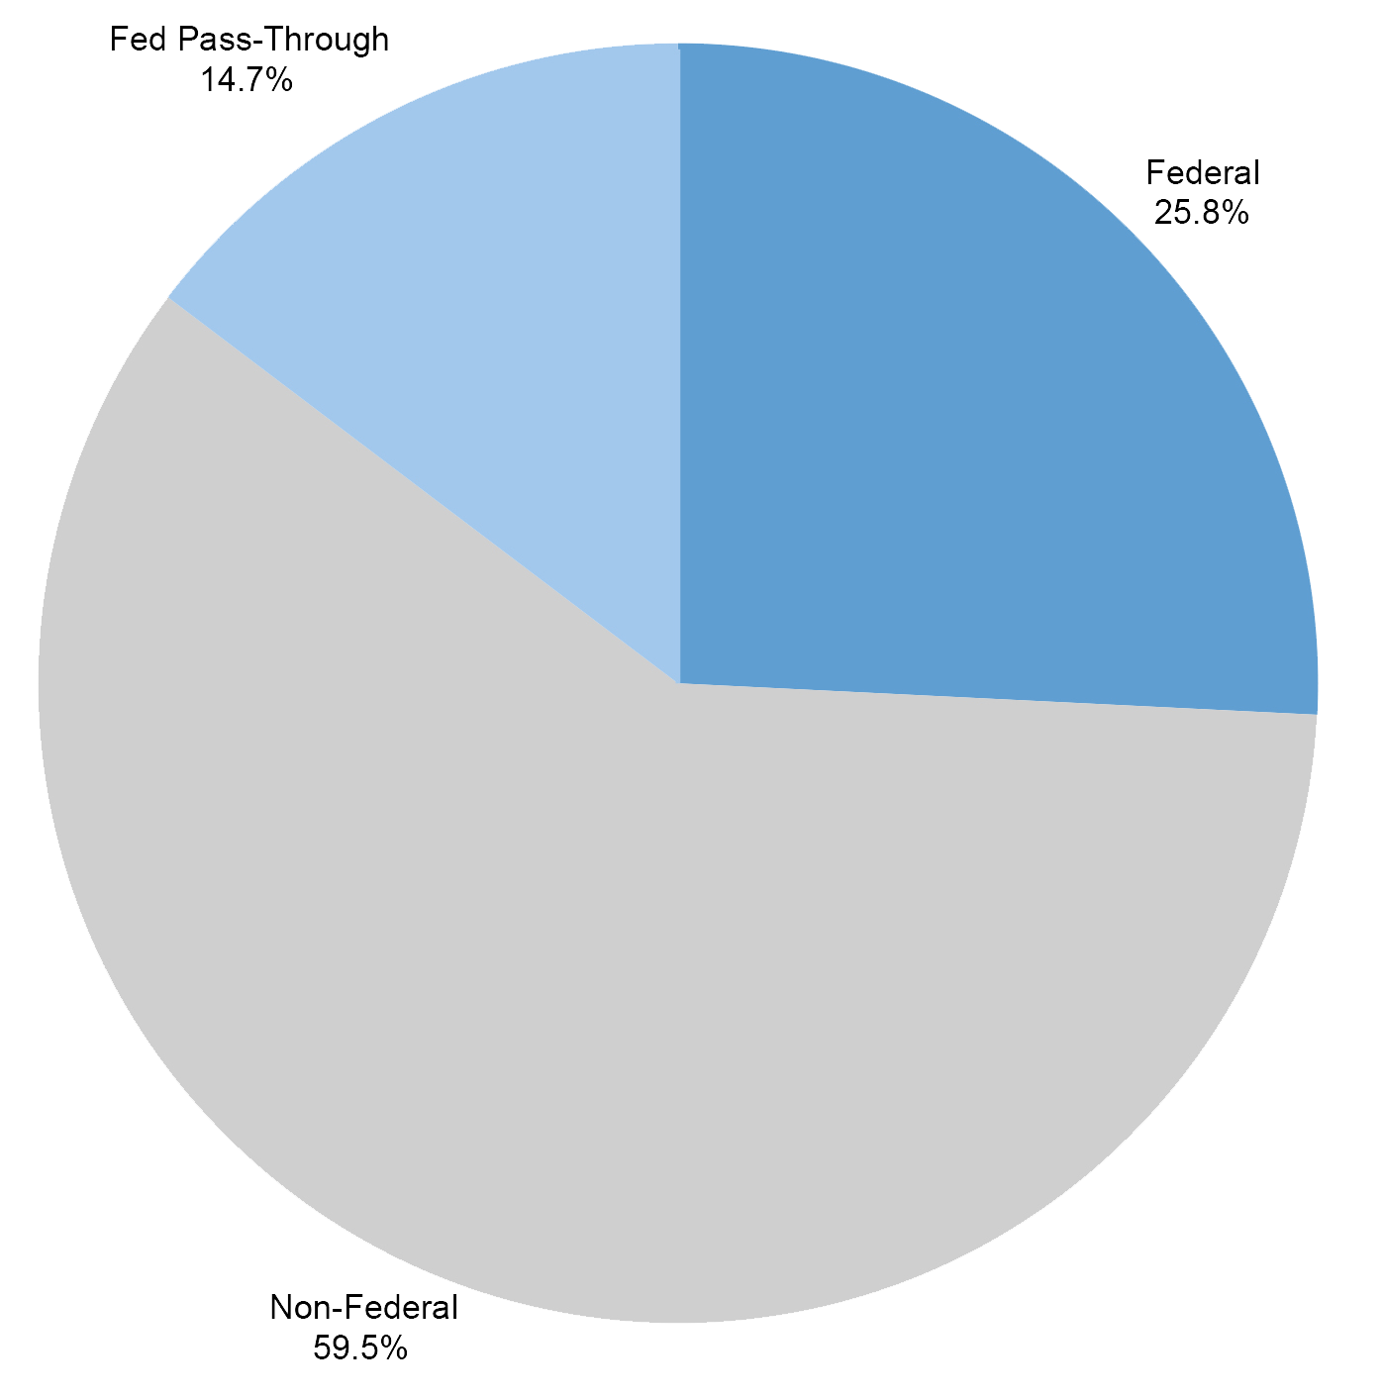
Awards by Source, Federal vs. Non-Federal
2014
2016
2018

Slide 27
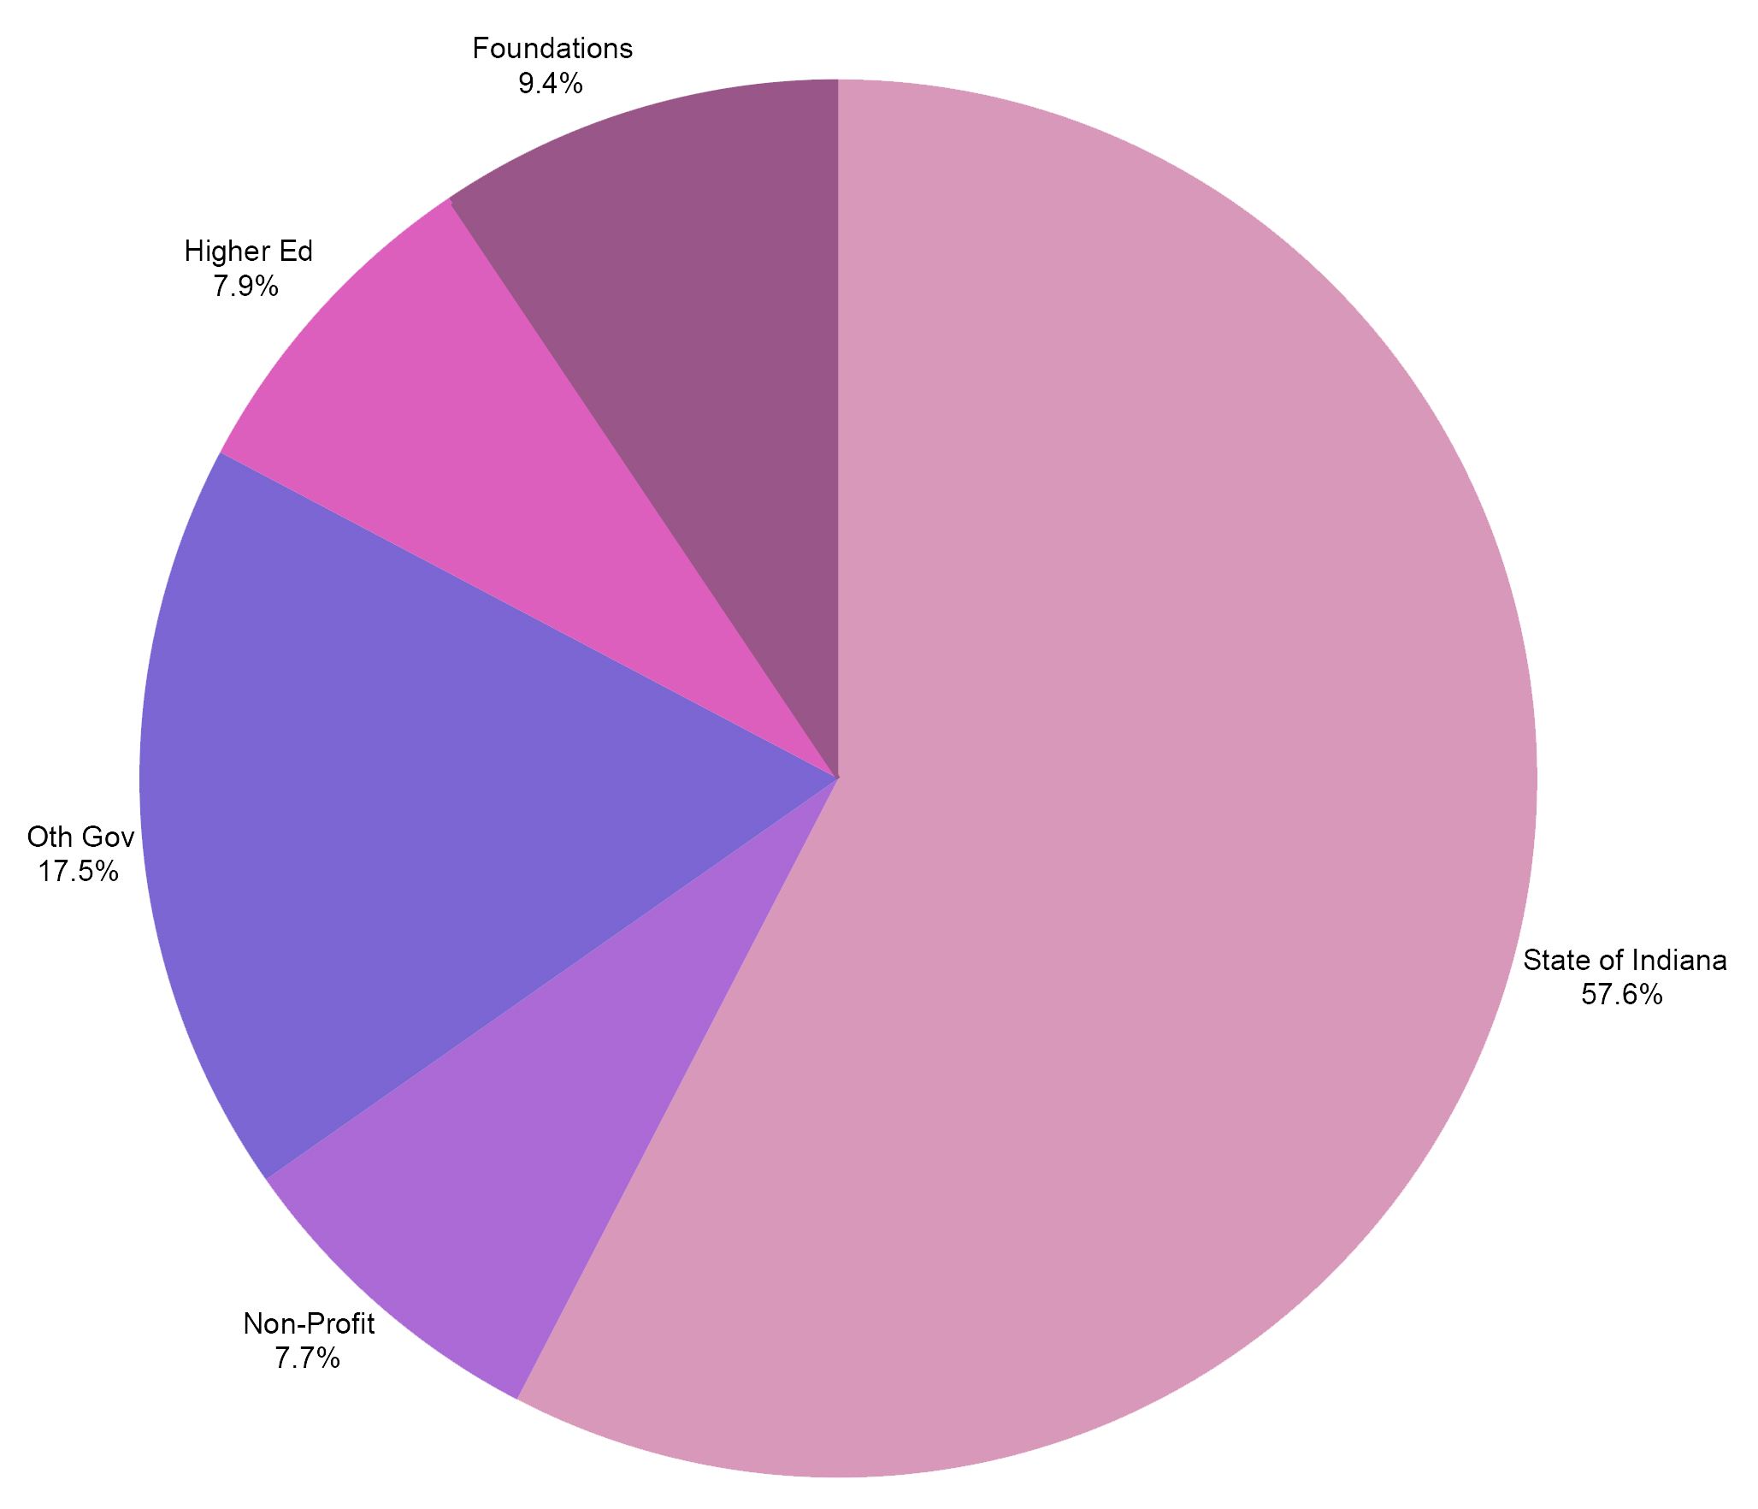
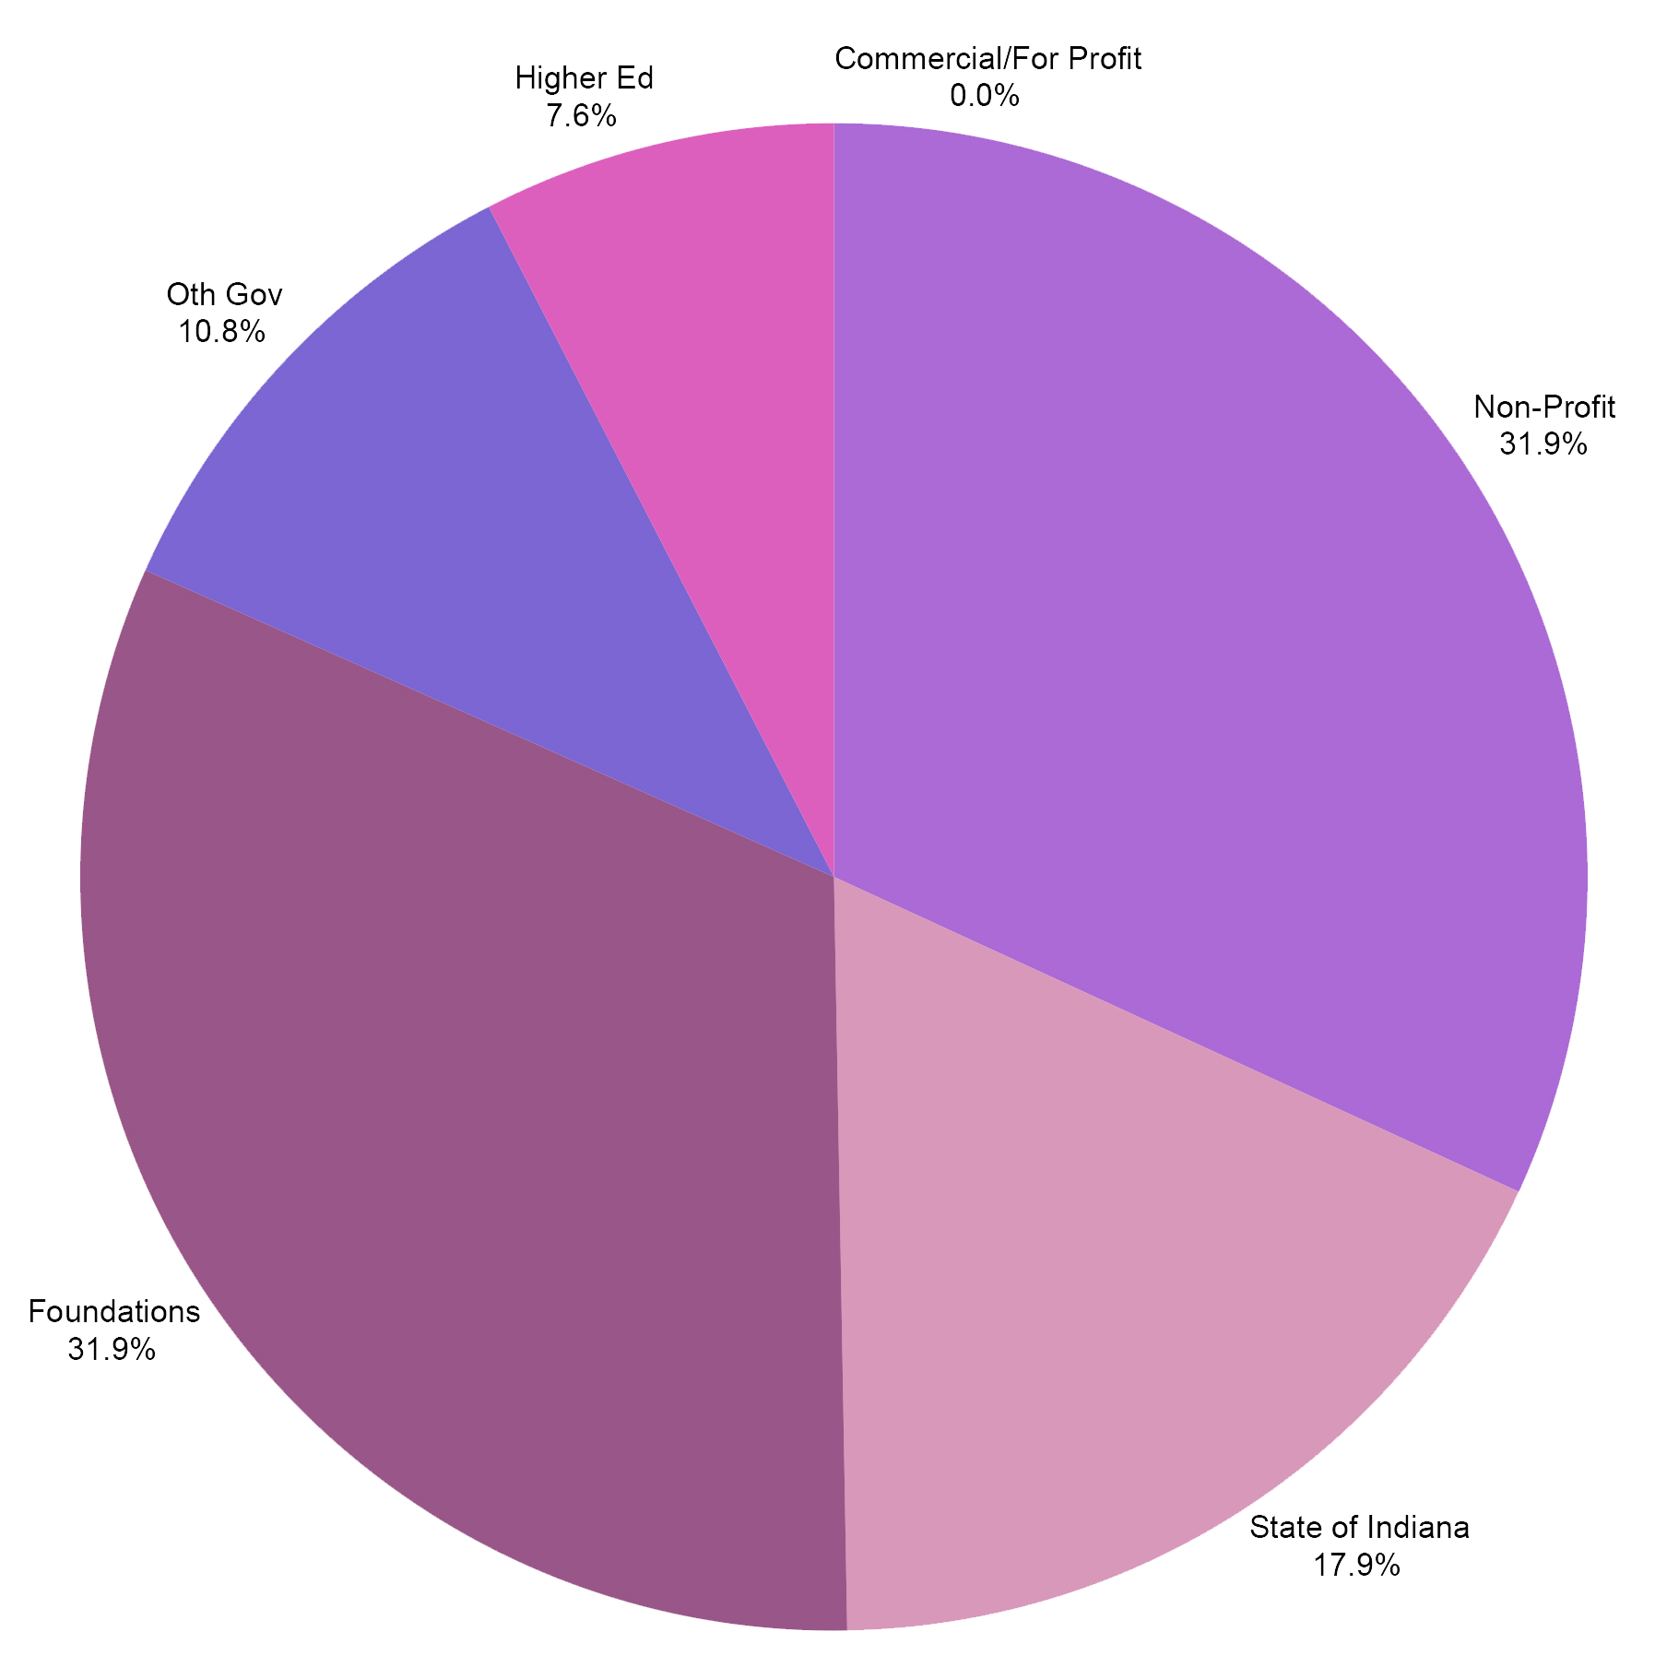
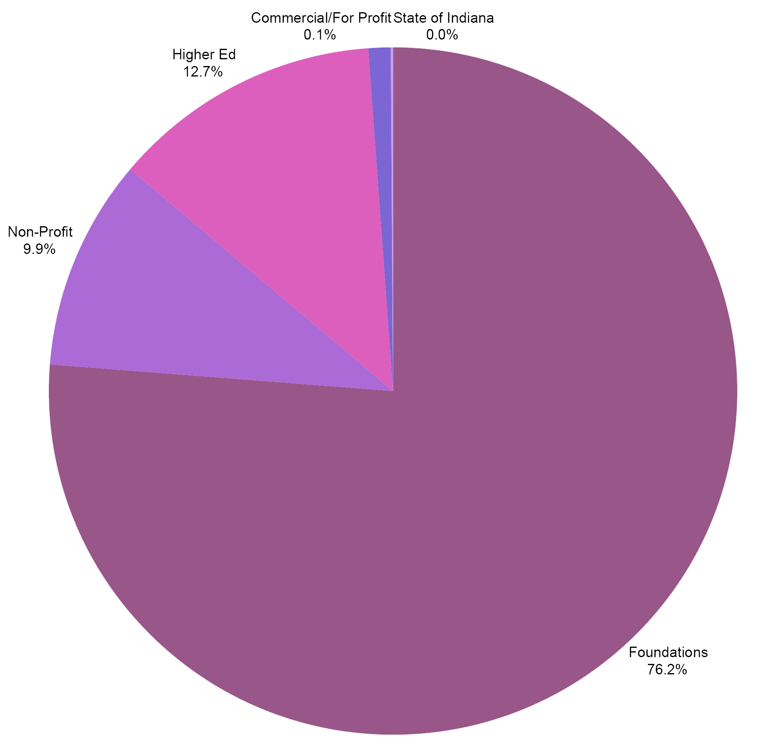
Source of Non-Federal Awards
2014
2016
2018

Slide 28
Creative Paths to Peace
Suzanne Eckes International Collaboration on Human Rights and Marginalized Population in Schools
Kempf
Valarie Akerson Assessment of K-12 Students' Science and Literacy Knowledge

Slide 29
Proffitt
Ana Maria Brannan Improving edTPA Inter-Rater Reliability and Training Daniel Castner Experiencing Quality Early Education: A Multi-Case Phenomenological Study Christopher Lubienski Using Geo-Spatial Analyses to Map the Arrangement of School Options in Indiana

Slide 30
Proffitt Summer Faculty Fellowship
Erik Jacobson Examining the Role of Teacher Gesture When Making Sense of Student Mathematical Work Tina O’Neal The Effects of Professional Development Workshops and Module-Based Guided Reflections on Pre-Service Teachers Self-Efficacy on the Usability and Implementation of Assistive Technology Gustave Weltsek Arts and Youths' Sense of Political Agency: An Arts Inquiry Partnership

Slide 31
2018-19 R&D Events
Date | Presenter | Topic
April 2019 | Faculty Panel (TBD) | Graduate Student Publishing: Managing Research Expectations and Collaborations
March 2019 | Panel Discussion: Sara Lubienski, Dubravka Sventina, Kevin Fosnacht, Gayle Buck | Navigating Graduate School and Beyond
February 2019 | Esen Gokpinar-Shelton , AJ Asomani-Adem | GradGrants Center
January 2019 | Adam Mills | FERPA and Human Subjects Research, Parental/ Guardian Consent and Child Assent in Research
November 2018 | All R&D Centers | Poster Session: Fostering Discussions with the R&D Research Centers and the projects they support
October 2018 | R&D Office | Internal Grants Poster Session
October 2018 | Mary Dwyer & Cory Rutz | Foundation Grants
September 2018 | Adam Mills | IU Human Subjects

Slide 32
Ed.D. Program Revisions
Background: We award the Ed.D. — not UGS
New Policies Approved by GSC and Policy Council:
Merger of program and research committees
Residency requirements set by programs
Programs no longer need to require a minor
#1 and #2 effective immediately.
#3: Programs must change requirements and go through approvals to eliminate minor.

Slide 33
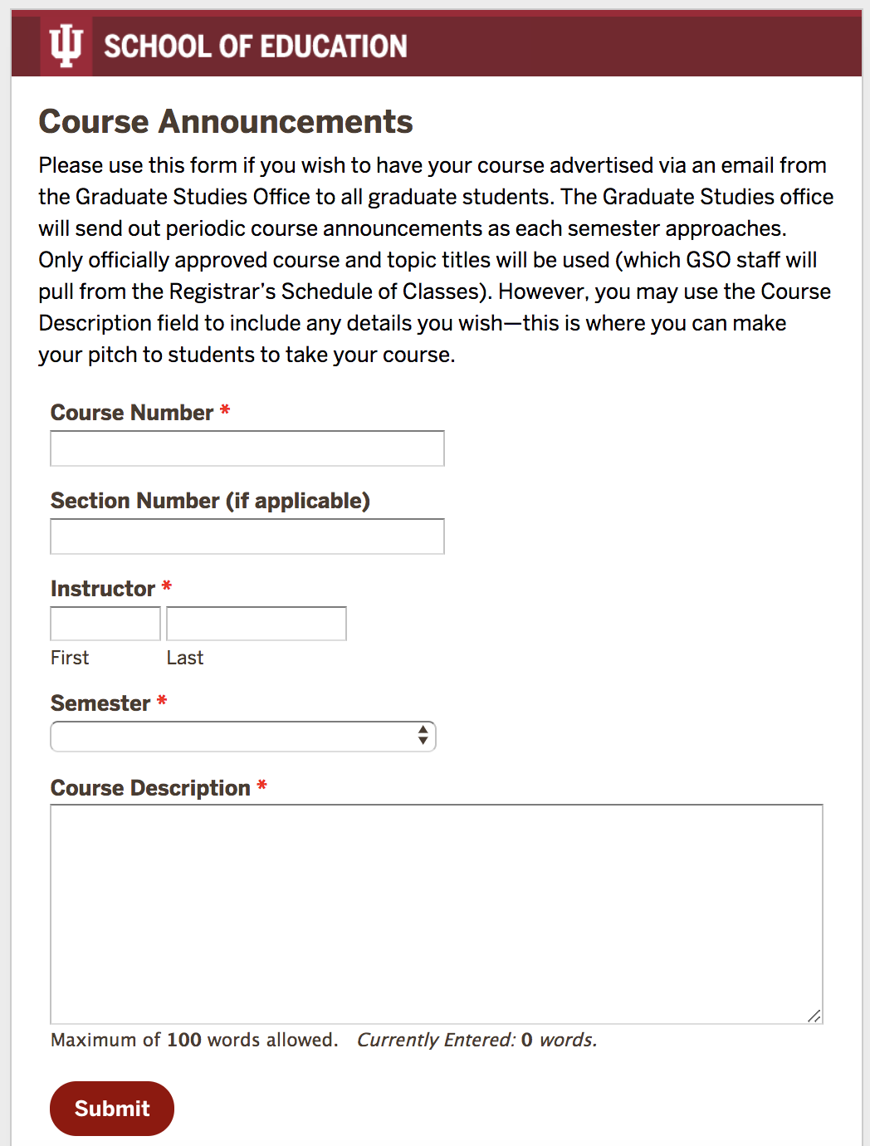
Other News
Graduate Student Convocation with Hooding Friday, May 3 at 6 pm
Course announcements now go to GSO (see your email).

Slide 34
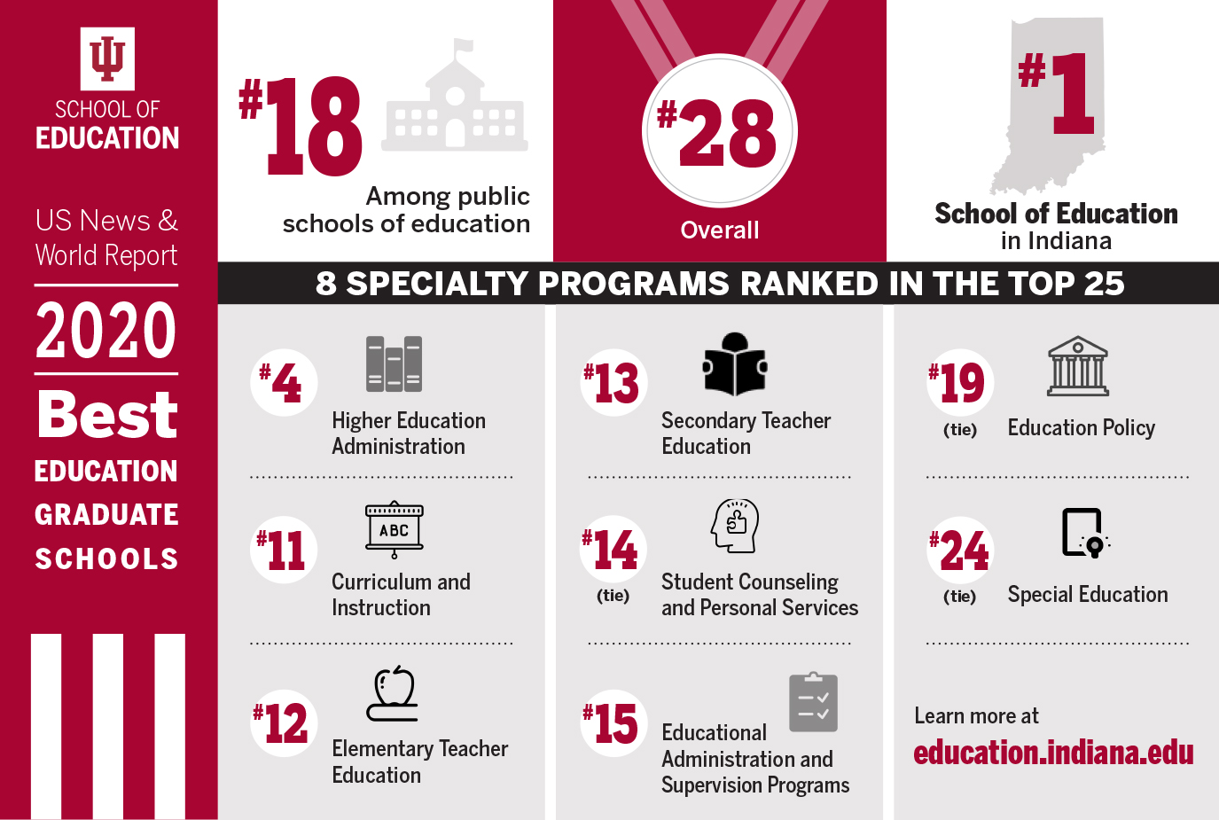

Slide 35
Q&A - Discussion

Slide 36
Other faculty updates

Slide 37


Slide 38
Lunch on atrium balcony

