Slide 1
WELCOME!
Fall Faculty Meeting
School of Education
December 12, 2008
The mission of the Indiana University School of Education is to improve teaching, learning, and human development in a diverse, rapidly changing and increasingly technological global society.

Slide 2
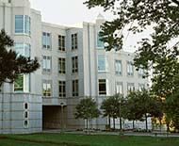
New Faculty in 2008
IUPUI
Mary Cole
Ryan Flessner
Crystal Hill
Jomo Mutegi
Jane Stephenson
Columbus Campus
Dia Sekayi

Slide 3
New Faculty in 2008
IUB
Ellen Vaughan
Keith Barton
Hsu-Min (Mina) Chiang
Ben Edmonds
Adam Maltese
Hannah Schertz
Karl Swenson
Gary Crow
Yonjoo Cho
Ray Haynes
Donna Adomat
Carmen L. Medina
Beth Lewis Samuelson
Gustave Weltsek
A total of 20 faculty members are joining in the School of Education.

Slide 4
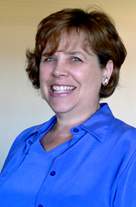
Mary Cole: Academic Specialist, ESL Education

Slide 5
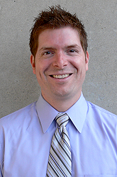
Ryan Flessner, Assistant Professor of
Math Education

Slide 6
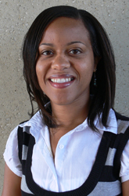
Crystal Hill: Assistant Professor of Math Education

Slide 7
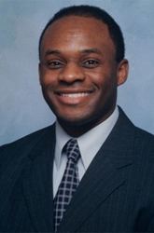
Jomo Mutegi: Associate Professor of
Science Education

Slide 8

Jane Stephenson: Assistant Professor of
Special Education

Slide 9
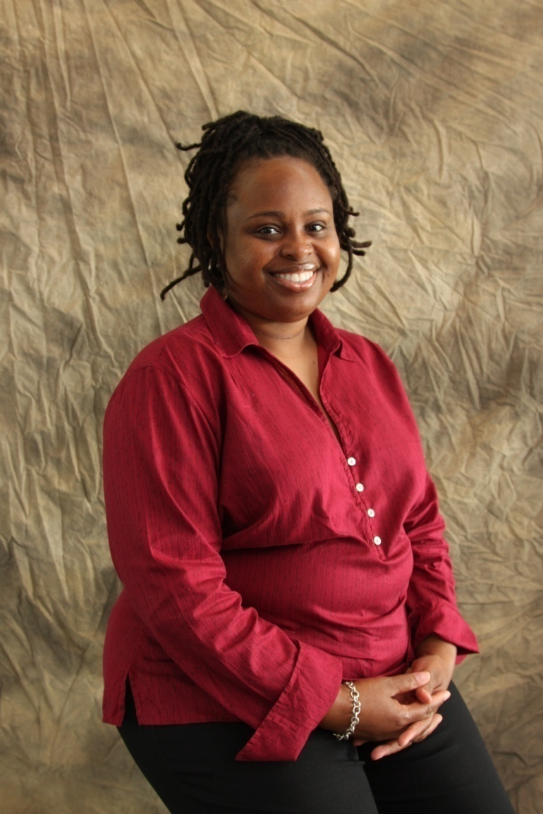
Dia Sekayi: Assistant Professor of Foundations of Education (Columbus Campus)

Slide 10
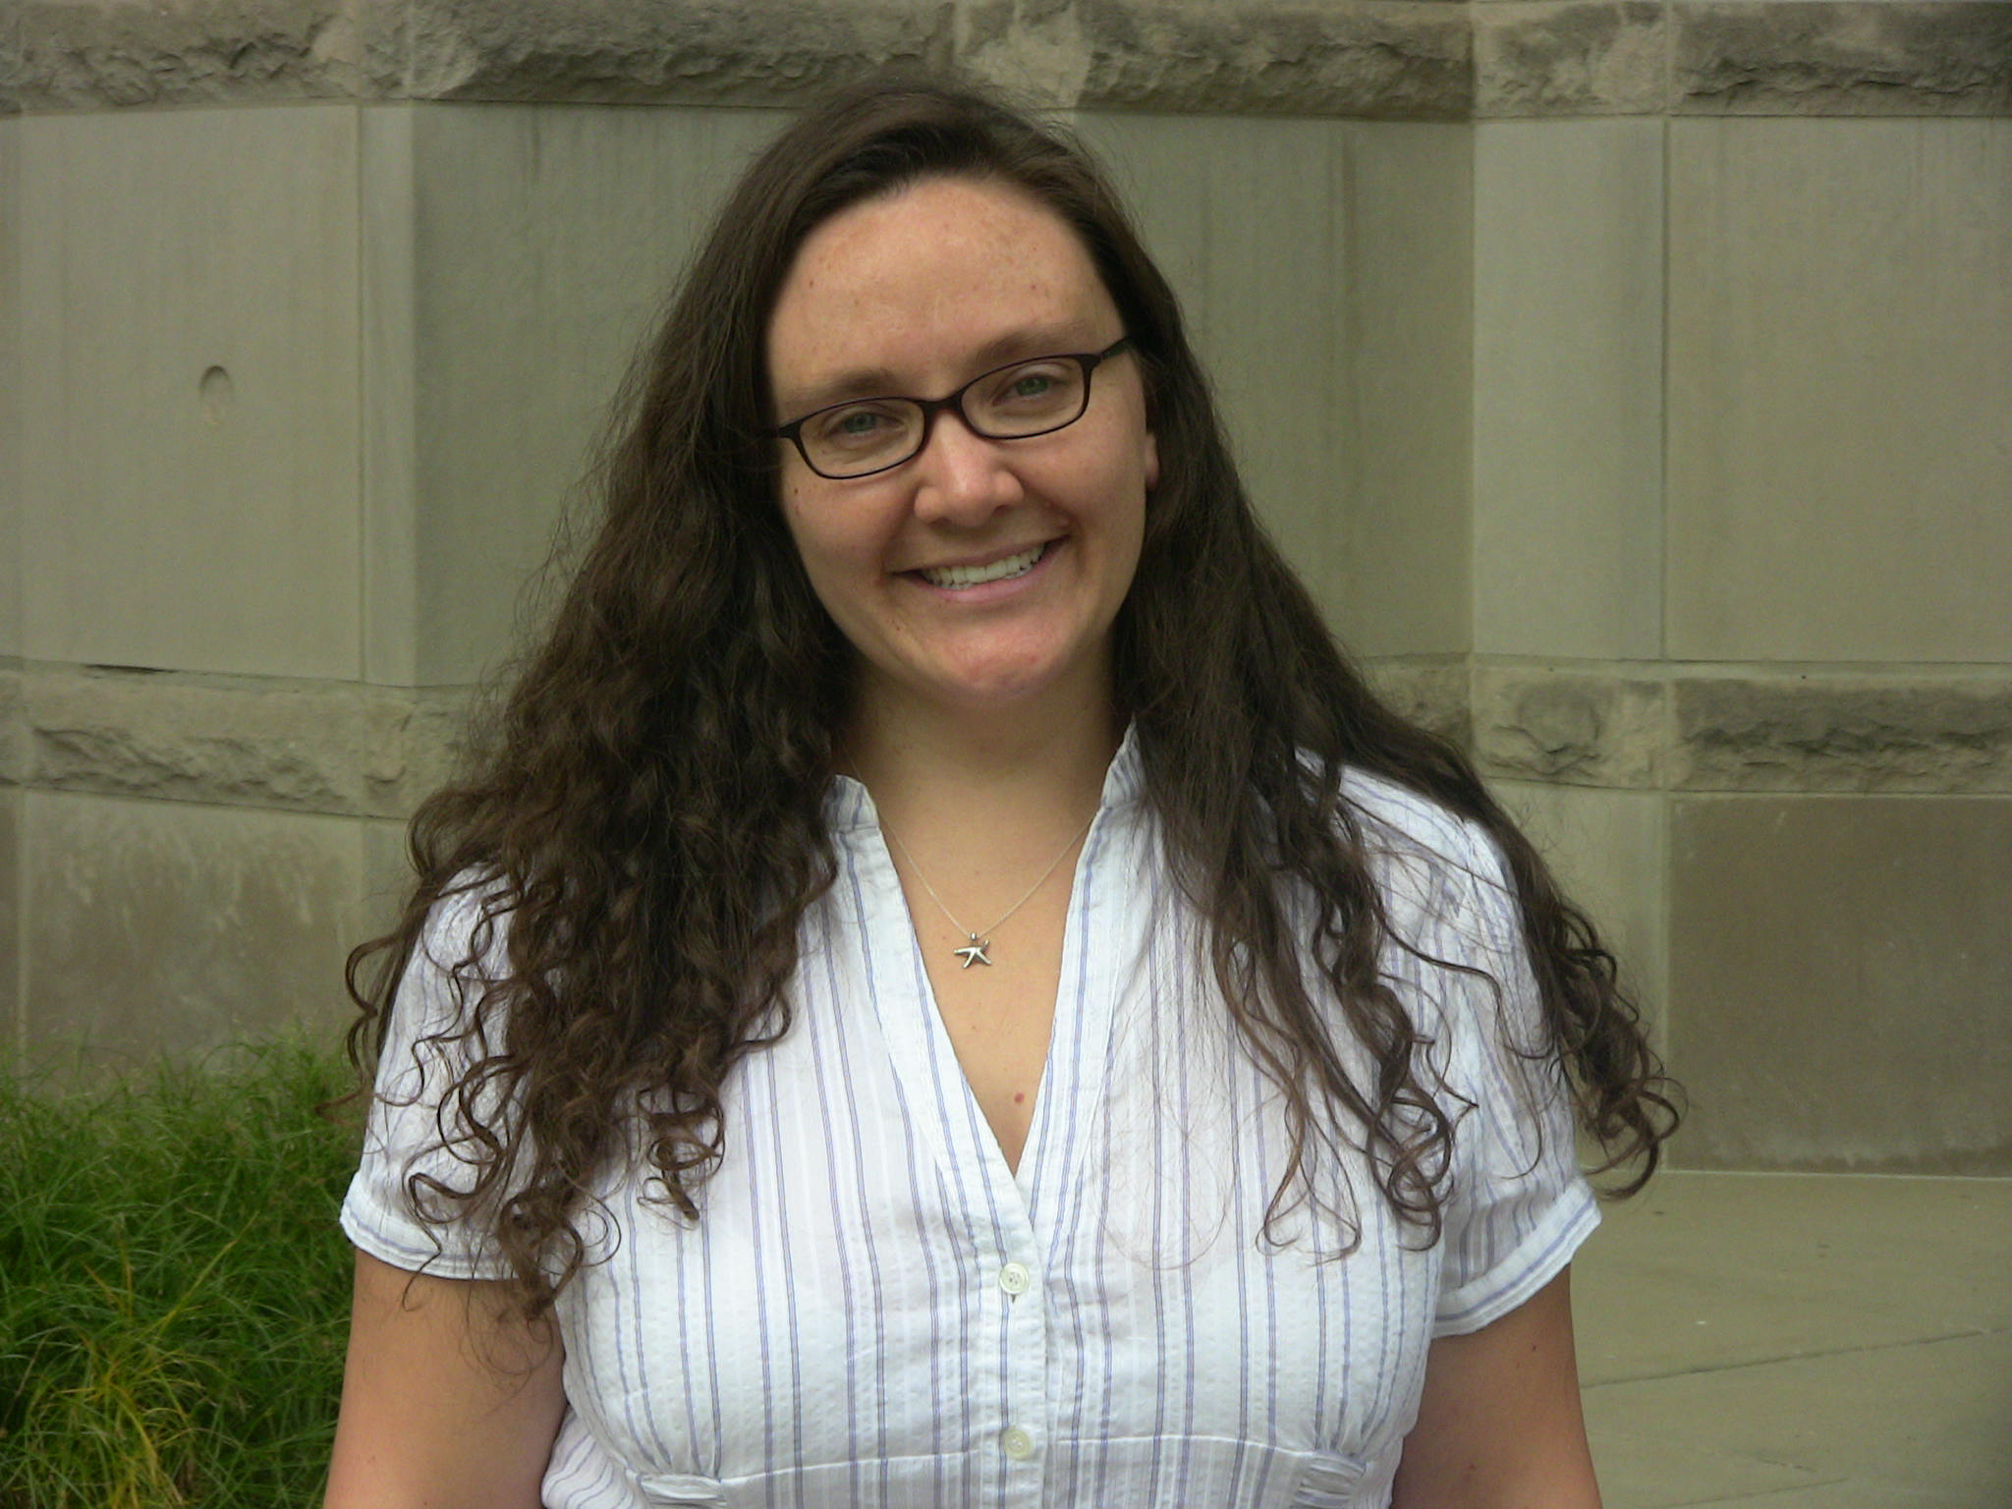
Ellen Vaughan: Assistant Professor of
Counseling Psychology in the
Department of Counseling & Educational Psychology
Notes:
10

Slide 11
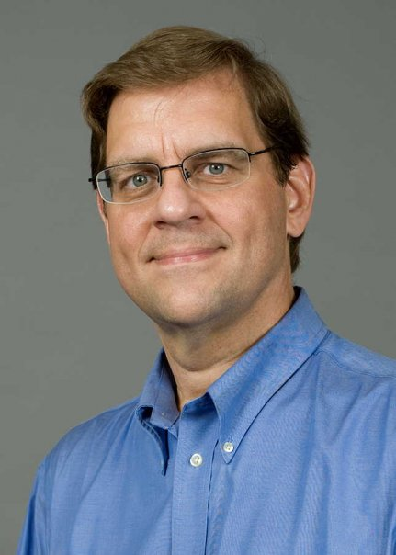
Keith Barton: Professor of
Social Studies Education in the
Department of Curriculum and Instruction

Slide 12
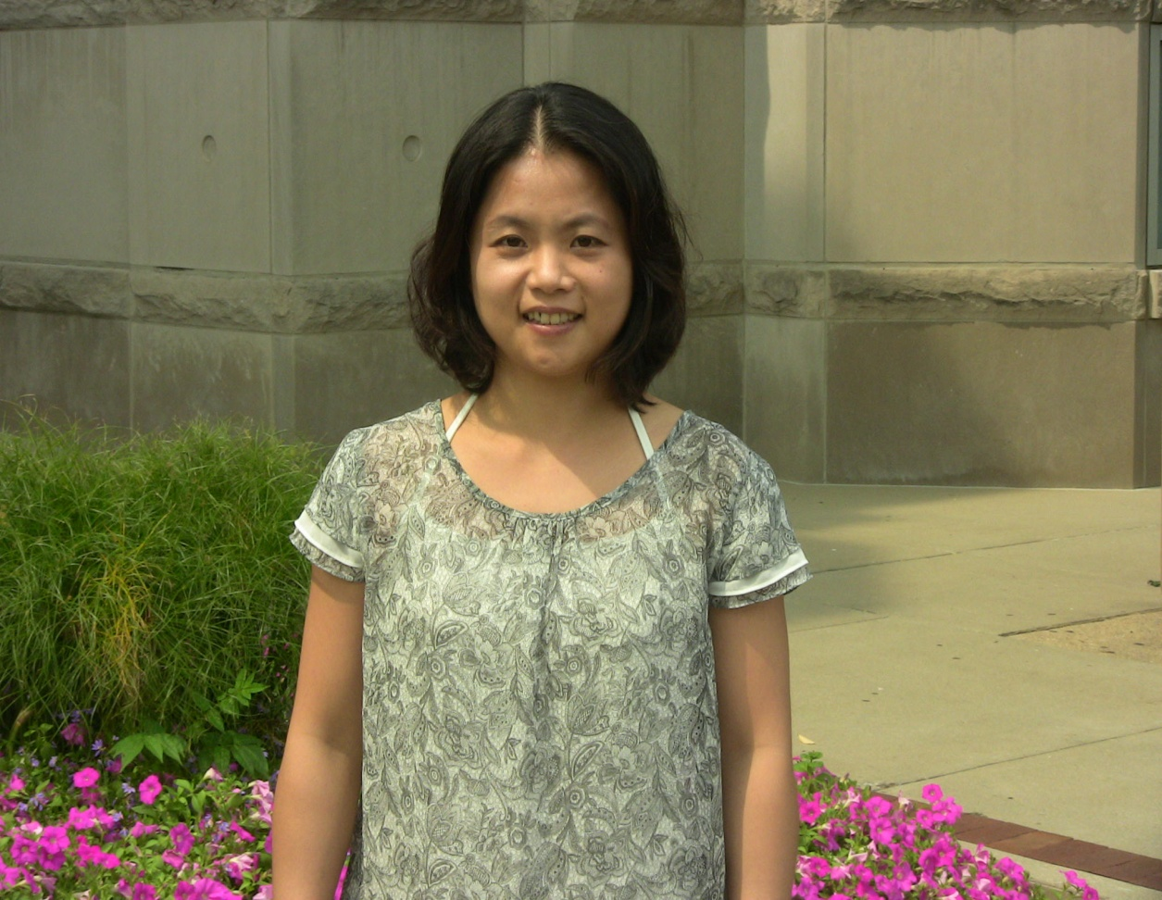
Hsu-Min (Mina) Chiang: Assistant Professor of Special Education in the
Department of Curriculum and Instruction

Slide 13
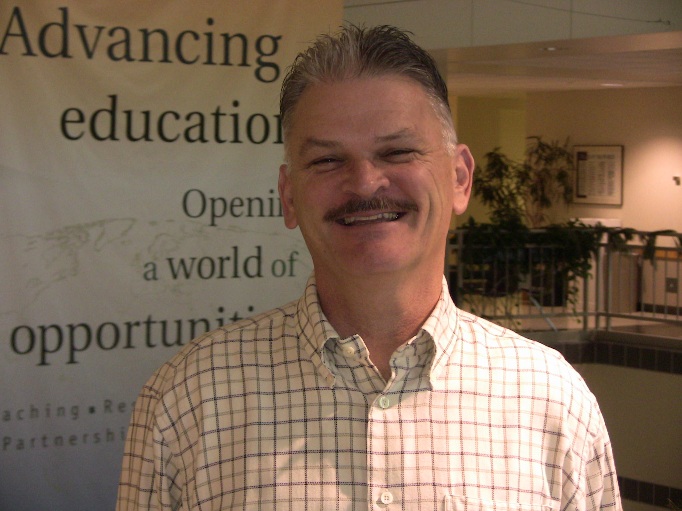
Ben Edmonds: Visiting Lecturer of
Special Education in the
Department of Curriculum and Instruction

Slide 14
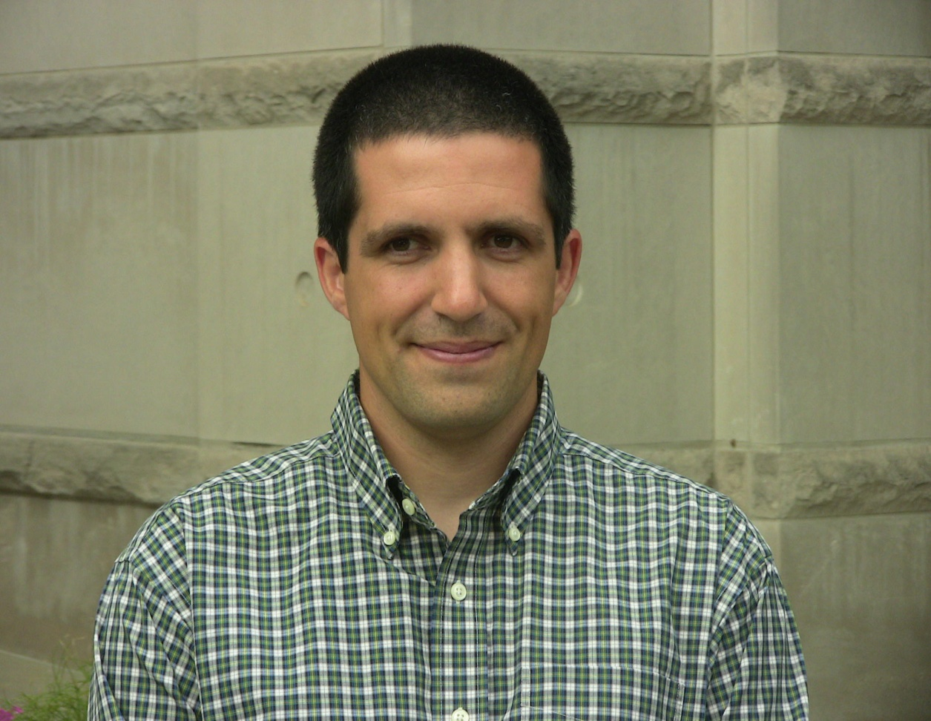
Adam Maltese: Assistant Professor of
Science Education in the
Department of Curriculum and Instruction

Slide 15
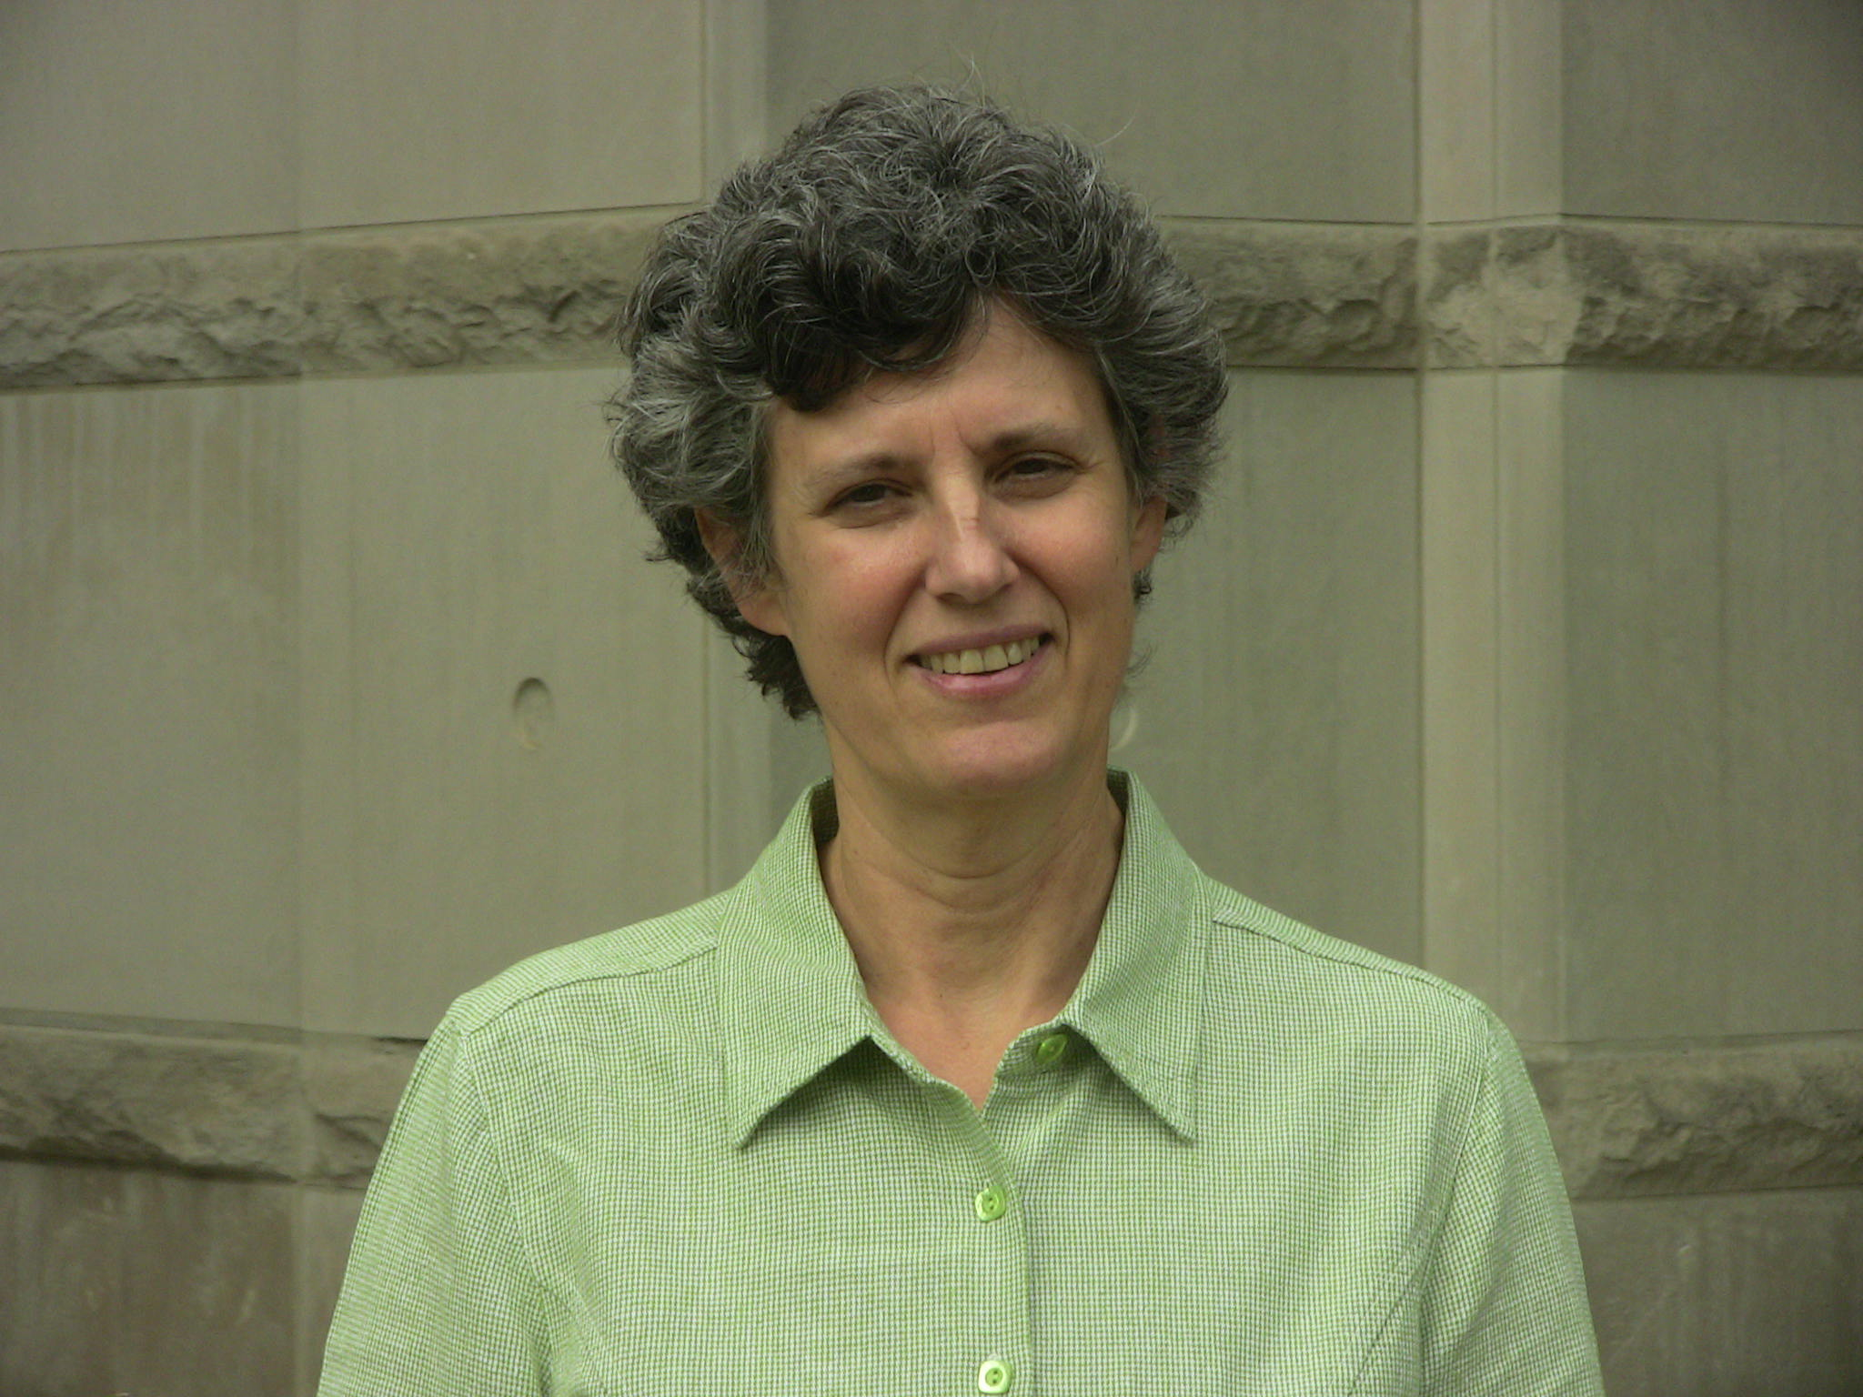
Hannah Schertz: Assistant Professor of
Special Education in the
Department of Curriculum and Instruction

Slide 16
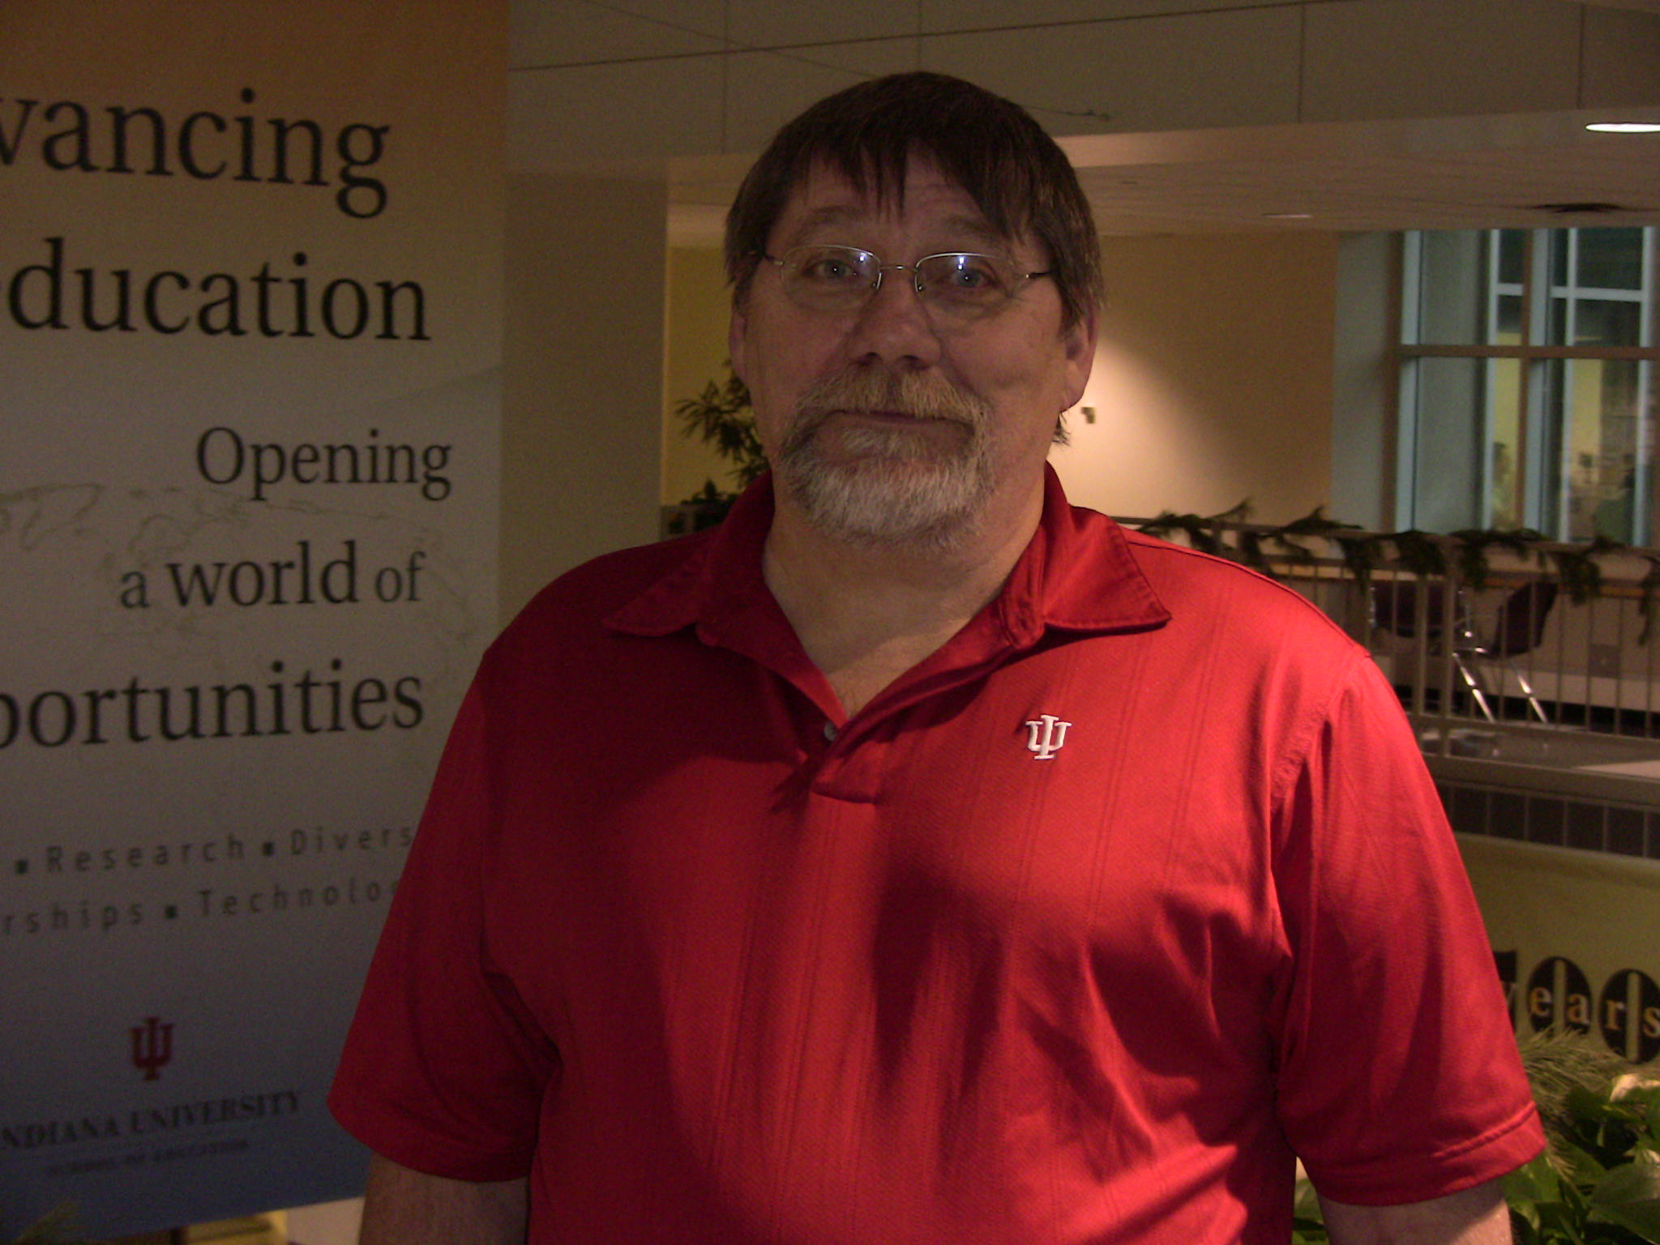
Karl Swenson: Visiting Lecturer of
Special Education in the
Department of Curriculum and Instruction

Slide 17
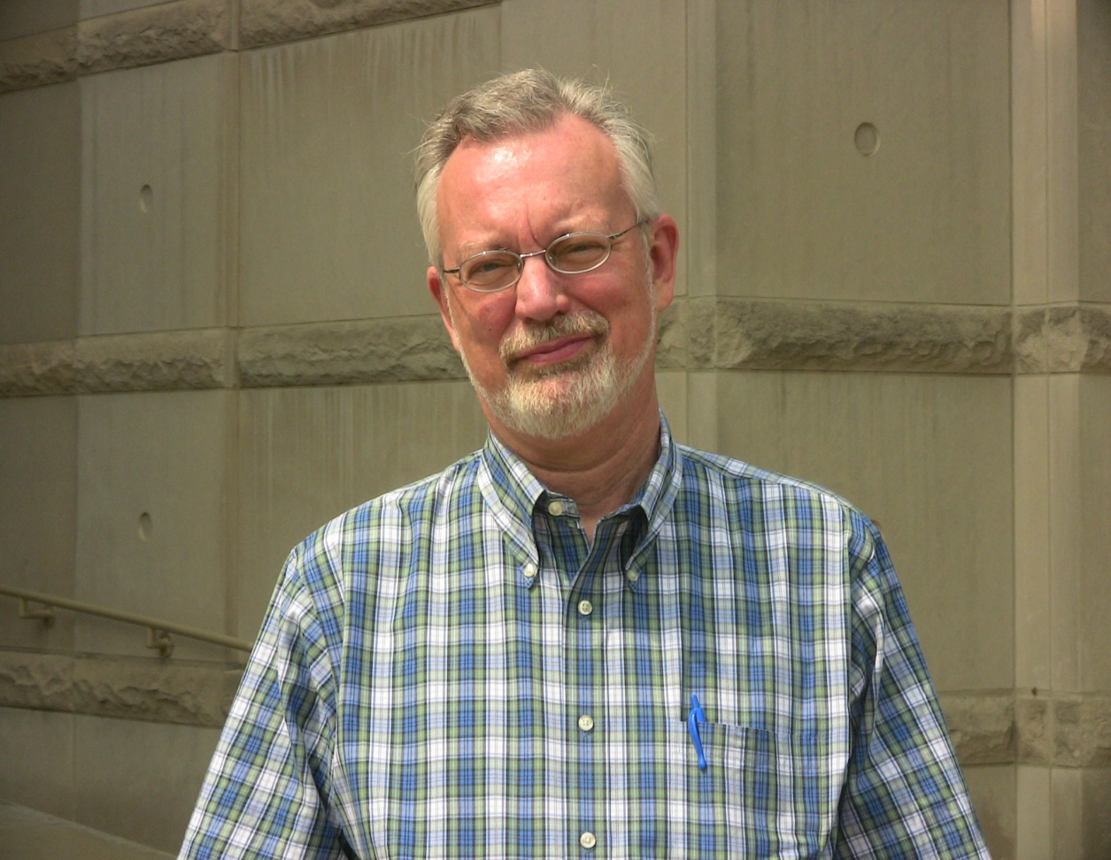
Gary Crow: Professor in the Department of Educational Leadership and Policy Studies

Slide 18
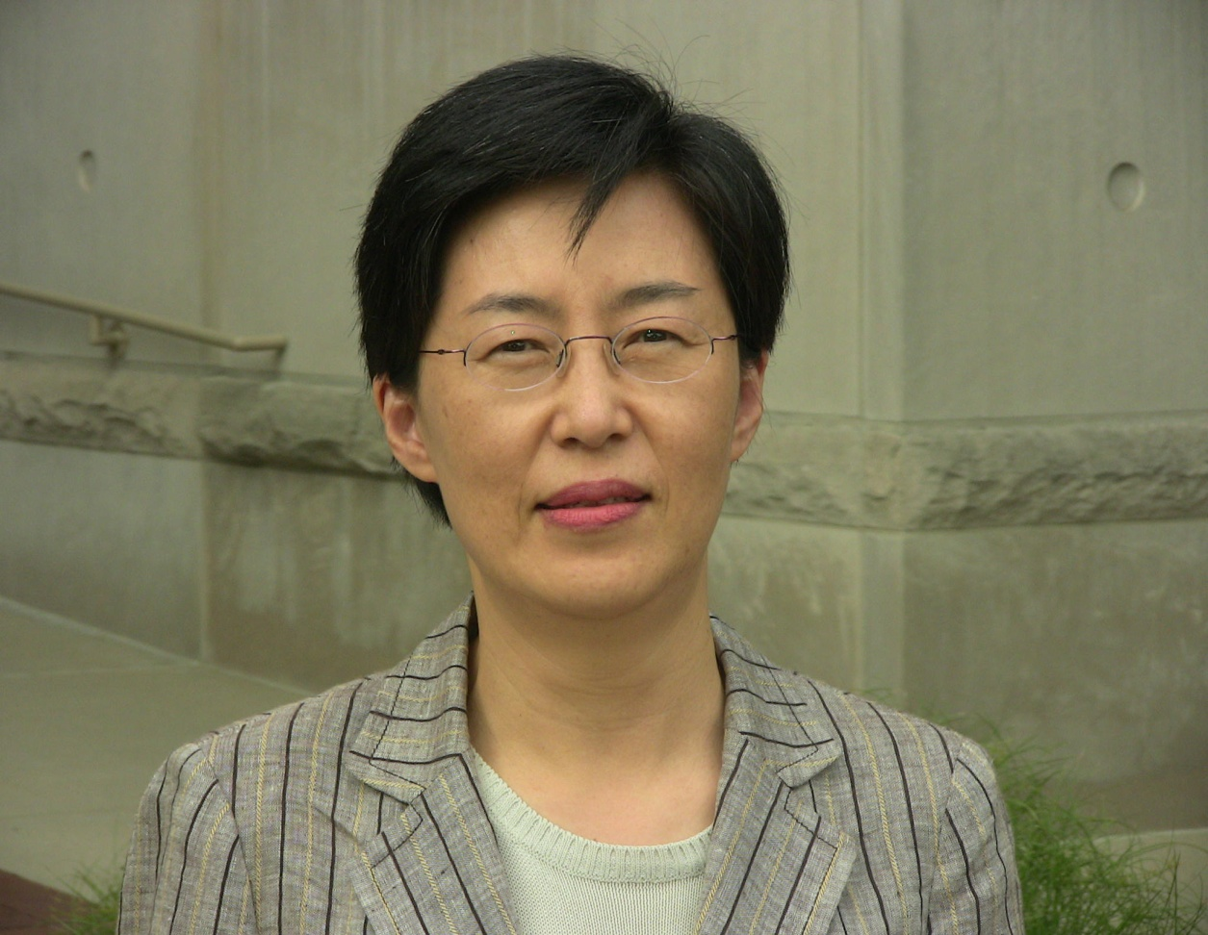
Yonjoo Cho: Assistant Professor in the
Department of Instructional Systems Technology

Slide 19
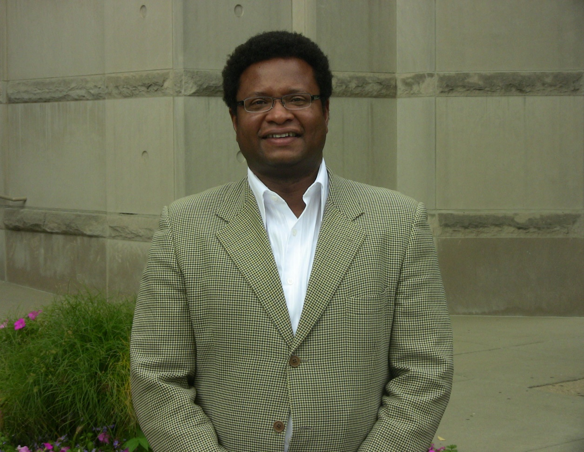
Ray Haynes: Assistant Professor in the Department of Instructional Systems Technology

Slide 20
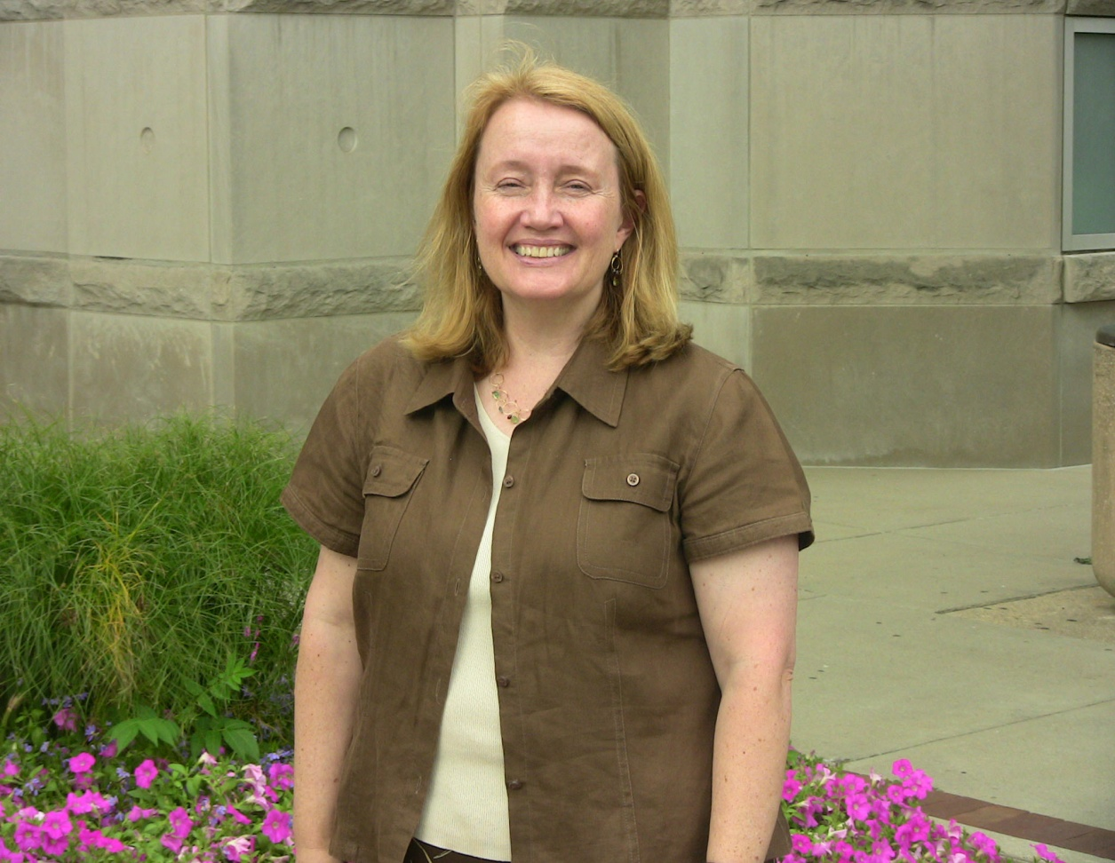
Donna Adomat: Assistant Professor in the Department of Literacy, Culture, and Language Education

Slide 21
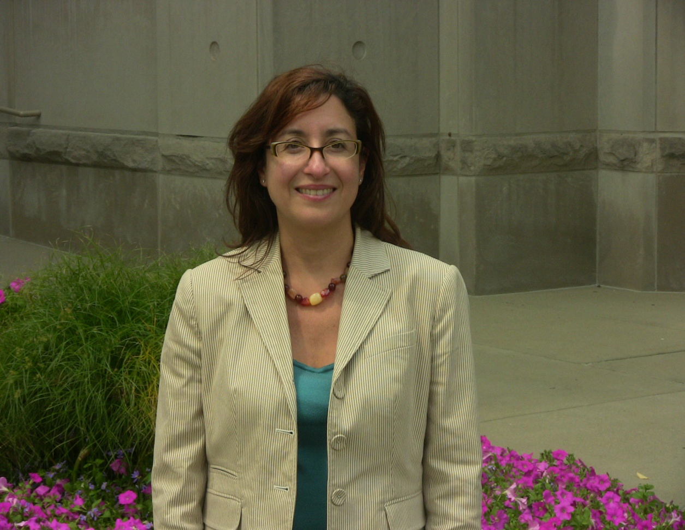
Carmen L. Medina: Assistant Professor of Elementary Education in the Department of Literacy, Culture, and Language Education

Slide 22
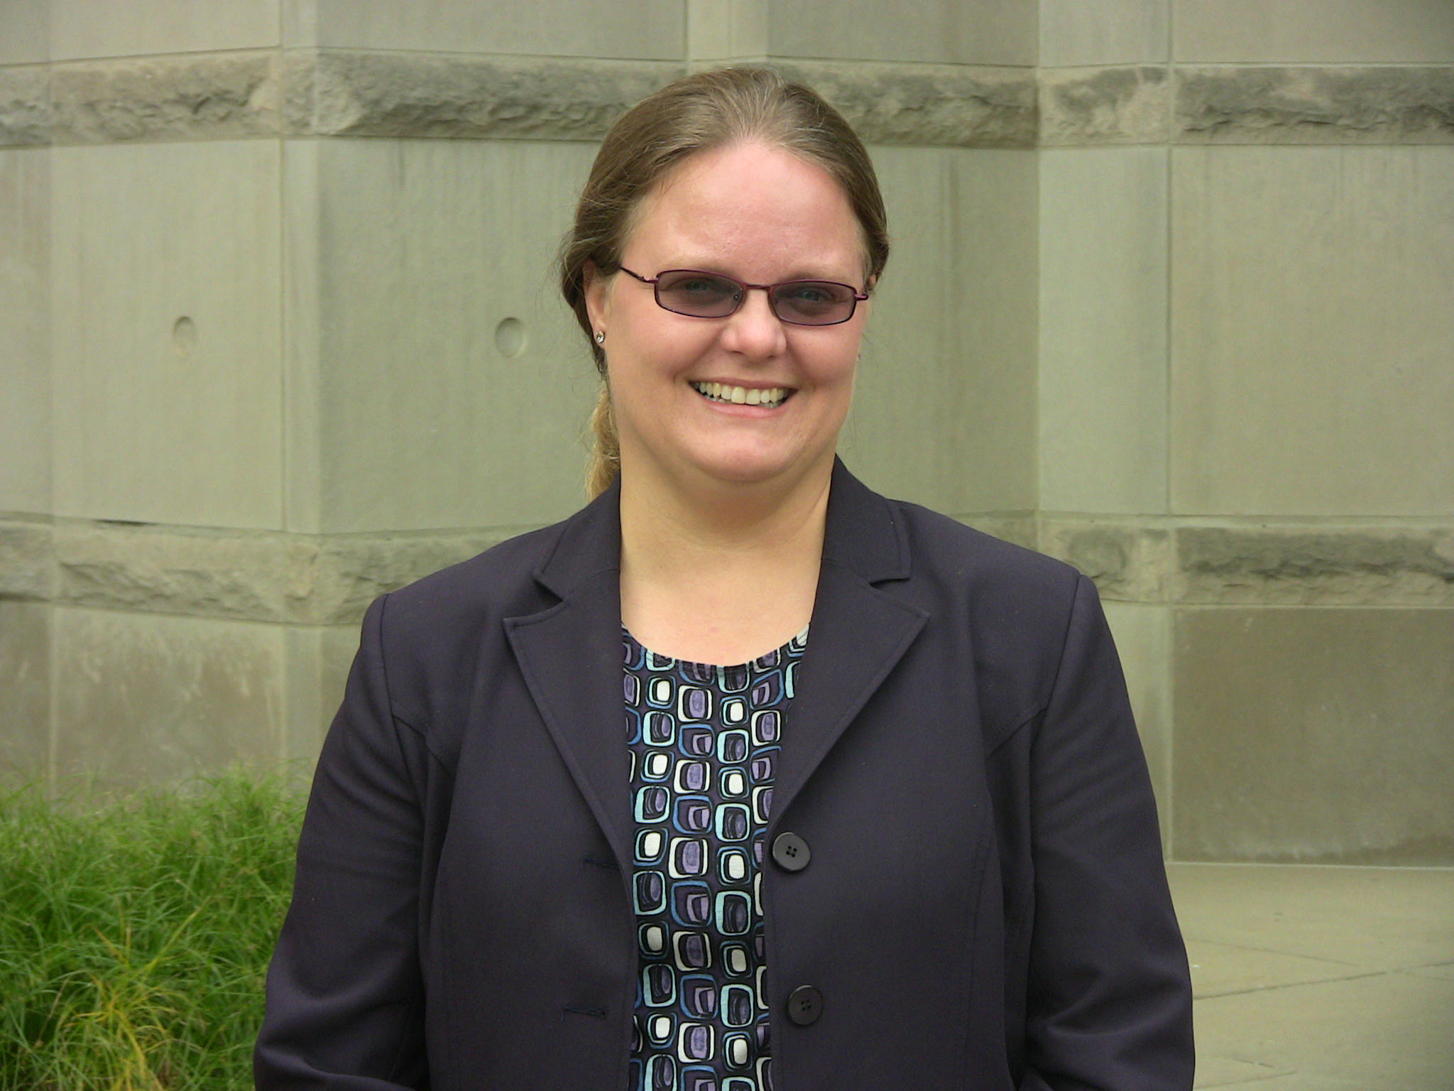
Beth Lewis Samuelson: Assistant Professor in the Department of Culture, Literacy, and Language Education

Slide 23
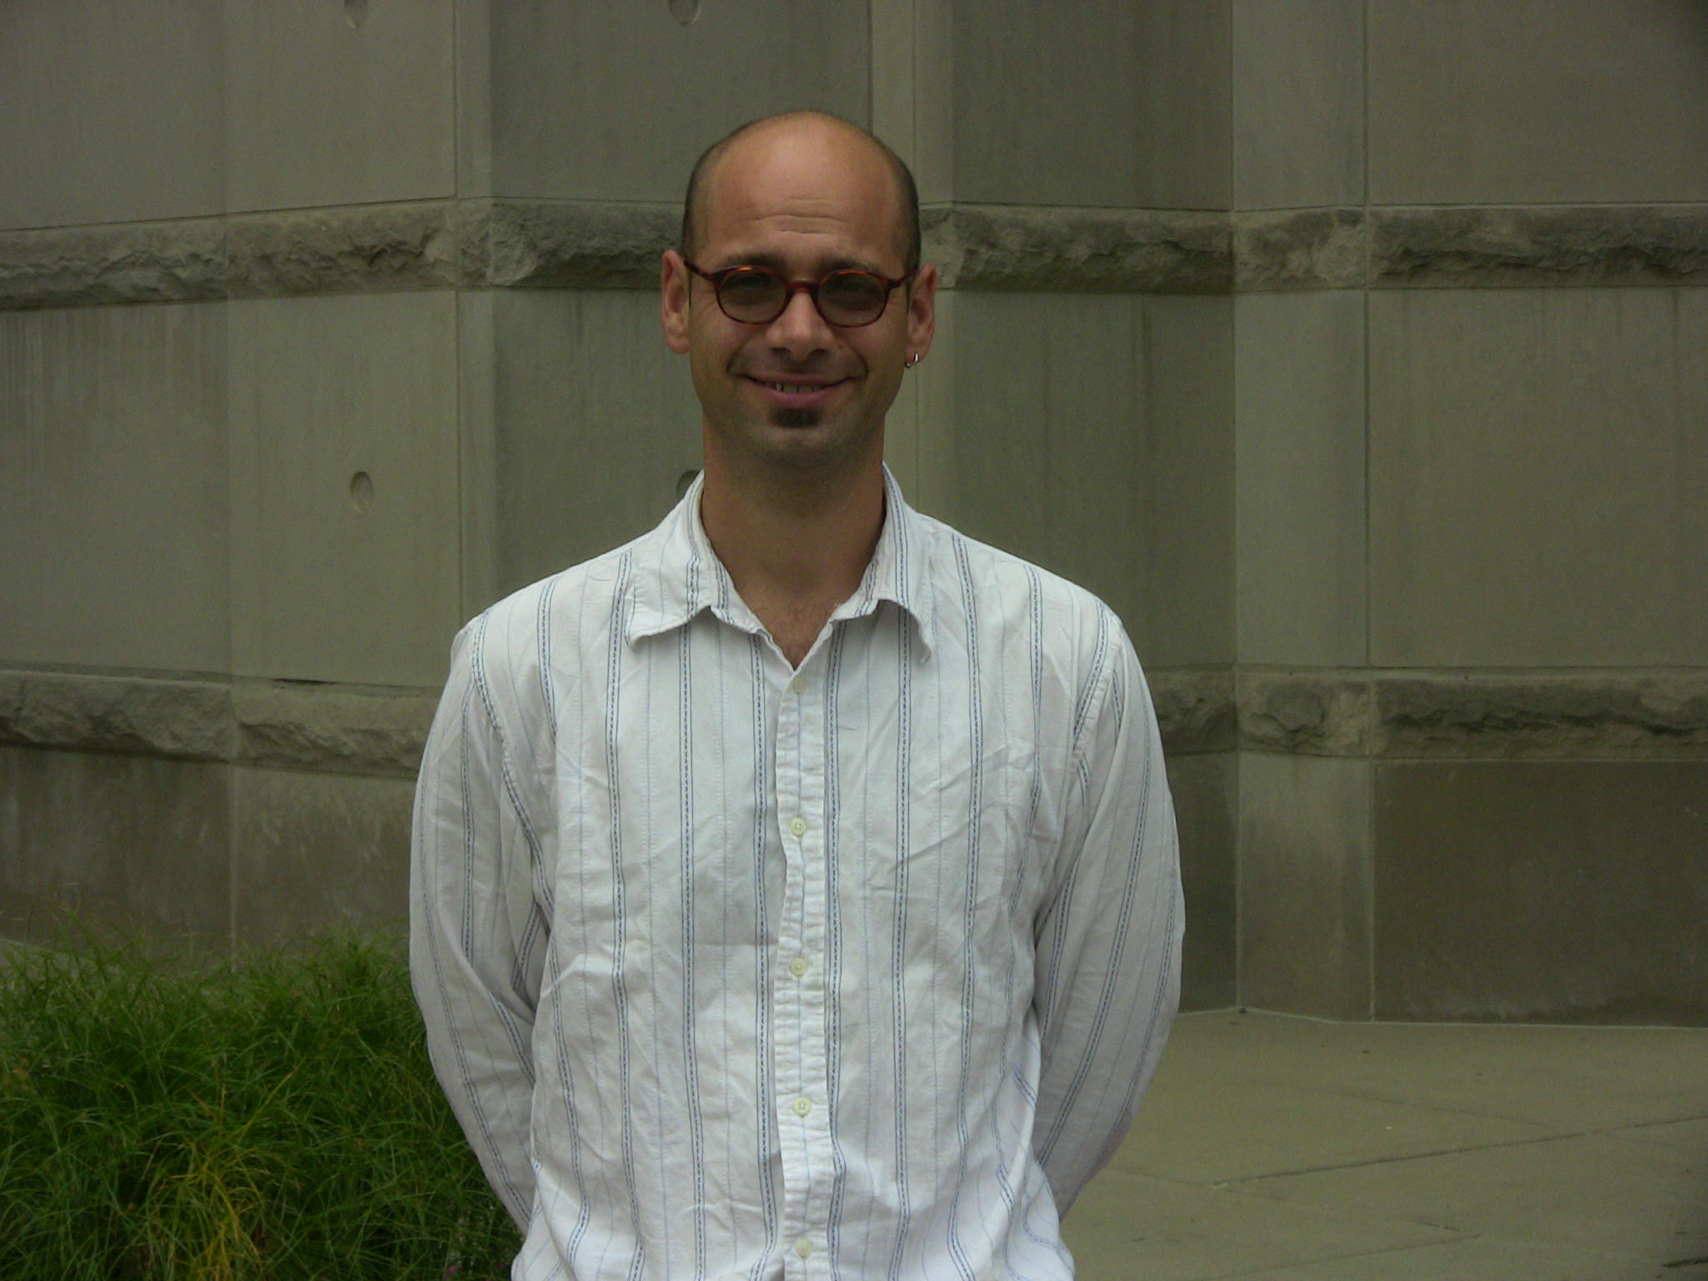
Gustave Weltsek: Visiting Assistant Professor in the Department of Literacy, Culture, and Language Education

Slide 24
IUPUI School of Education Updates
Notes:
24

Slide 25
FALL ‘08 UNDERGRAD ENROLLMENT
 | 2007 | 2008 | 2009 | Net Difference | % Change
Course Levels
100 | 136 | 140 | 342 | 202 | 144.3%
200 | 914 | 943 | 1222 | 2789 | 29.6%
300 | 4447 | 4318 | 3746 | -572 | -13.2%
400 | 2903 | 3115 | 3153 | 38 | 1.2%
TOTAL HOURS | 8400 | 8516 | 8463 | -53 | -0.6%
Notes:
25

Slide 26
FALL ‘08 GRADUATE ENROLLMENT
 | 2007 | 2008 | 2009 | Net Difference | % Change
Course Levels
500 | 3182 | 2646 | 2722.5 | 76.5 | 2.9%
600 | 186 | 327 | 351 | 24 | 7.3%
700 | 33 | 29 | 58 | 29 | 100%
900 | 12 | 18 | 24 | 6 | 33.3%
TOTAL HOURS | 3413 | 3020 | 3155.5 | 135.5 | 4.5%

Slide 27
Spring ‘09 UNDERGRAD ENROLLMENT
 | 2007 | 2008 | 2009 | Net Difference | % Change
Course Levels
100 | 0 | 0 | 168 | 168 | 0%
200 | 651 | 803 | 1137 | 334 | 41.6%
300 | 3857 | 3588 | 3079 | -509 | -14.2%
400 | 3272 | 3449 | 3065 | -384 | -11.1%
TOTAL HOURS | 7780 | 7840 | 7449 | -391 | -5%
Notes:
27

Slide 28
Spring ‘09 GRADUATE ENROLLMENT
 | 2007 | 2008 | 2009 | Net Difference | % Change
Course Levels
500 | 2358 | 2337.5 | 2374 | 36.5 | 1.6%
600 | 129 | 174 | 99 | -75 | -43.1
700 | 17 | 38 | 37 | -1 | -2.6%
900 | 6 | 18 | 6 | -12 | -66.7%
TOTAL HOURS | 2510 | 2567.5 | 2516 | -51.5 | -2%

Slide 29
TOTAL CREDIT HOURS
Percent Change:
  Fall ‘08 0.7%
  Spring ’09 -4.3%
(Point in Cycle 12/7/08)

Slide 30
BUDGET – ’08-’09 INCOME
(As of 9-30-08)
INCOME | ‘08-’09 Budget | Operational Income & Expense | Projected/Encum-bered | Total Income & Expense | Variance
UG Tuition | 3,548,537 | 1,685,666 | 1,765,341 | 3,451,007 | (97,530)
Grad “ | 3,844,070 | 1,857,209 | 1,836,873 | 3,694,082 | (149,988)
Fees | 436,400 | 250,399 | 258,619 | 509,018 | 72,618
Subtotal | 7,829,007 | 3,793,274 | 3,860,833 | 7,654,107 | (174,900)
State Appropr. | 2,314,231 | 578,556 | 1,735,675 | 2,314,231 | --
Other Rev. | 3,000 | 56,331 | 14,924 | 71,255 | 68,255
Indirect | 25,000 | 24,840 | 15,160 | 40,000 | 15,000
Assessments | (3,026,716) | (705,706) | (2,321,010) | (3,026,716) | --
TOTAL | 7,144,522 | 3,747,295 | 3,305,582 | 7,052,877 | (91,645)

Slide 31
BUDGET – ’08-’09 EXPENSES
EXPENSE | ‘08-’09 Budget | Operational Income & Expense | Projected - Encum-bered | Total Income & Expense | Variance
Compensation | 6,435,119 | 1,384,119 | 4,713,585 | 6,097,704 | 337,415
Financial Aid | 166,260 | 93,650 | 90,110 | 183,760 | (17,500)
Other Exp. | 396,573 | 111,918 | 348,525 | 460,443 | (63,870)
Travel | 56,000 | 8,434 | 57,566 | 66,000 | (10,000)
Reserves & Transfers | 90,570 | 59,144 | 44,512 | 103,656 | (13,086)
TOTAL EXPENSES | 7,144,522 | 1,657,265 | 5,254,298 | 6,911,563 | 232,959
VARIANCE | -- | 2,090,030 | (1,948,716) | 141,314 | 141,314

Slide 32
Recently Funded Projects
Learning to Teach, Teaching to Learn Dual Licensure Teacher Education Program
(Fisher, Rogan, Dare)
  USDOE Office of Special Education Programs
Examining the State of the Welcome to Learning Program in Primary Schools of Indiana- Young Audiences (Debora Hinderliter Ortloff)
  Chase Foundation
Future Promises Program (Debora Hinderliter Ortloff)
  Women’s Fund
Notes:
32

Slide 33
Recently Funded Projects
Comprehensive Teacher Education Reform for English Language Learners (Annela Teemant)
Circle City Learning Community at George Washington Community High School (Monica Medina)
ACT Out Program/Peace Learning Center Curriculum Mapping Project (Rob Helfenbein)
School of Medicine Faculty Affairs and Professional Development Partnership (Joshua Smith)

Slide 34
Urban Center for the Advancement of STEM Education (UCASE)
Woodrow Wilson Indiana Teacher Fellowship Program (Charlie Barman)
Woodrow Wilson National Fellowship Foundation
The Noyce Scholars Program at Indiana University-Purdue University Indianapolis- Supplemental (Kathy Marrs)
Notes:
34

Slide 35
Submitted RFPs
Mathematics & Science Partnership with IPS (1 math, 1 science)
  Indiana Department of Education
HIV Prevention for Middle School Students
  Marion County Health Dept. & IN. Dept. of Education
Extension of International Education
  Bradley Foundation
School of Nursing
  Robert Wood Johnson Foundation
Ready to Learn, Ready to Earn
  United Way
Notes:
35

Slide 36
Staffing Updates
Kathleen Allspaw, Research Associate (UCASE)
Shanna Stuckey, Project Coordinator (CUME)
6 Graduate Assistants
14 graduate and undergraduate students

Slide 37
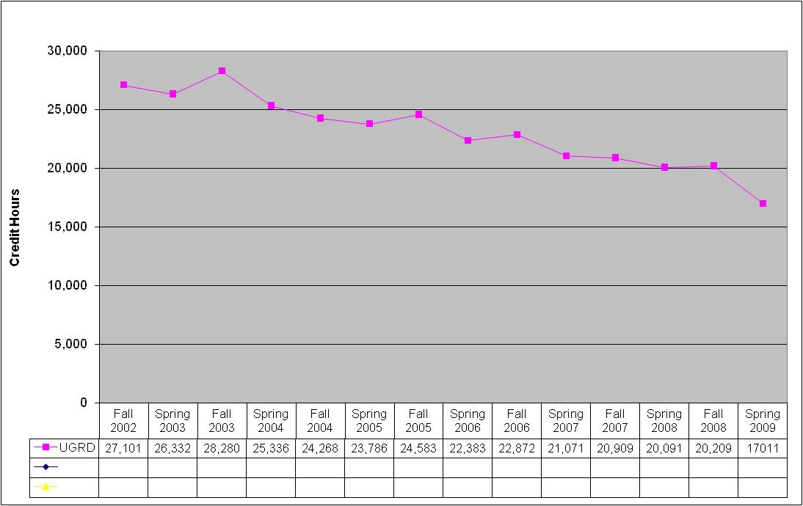
Undergraduate Credit Hour Trends for BL

Slide 38
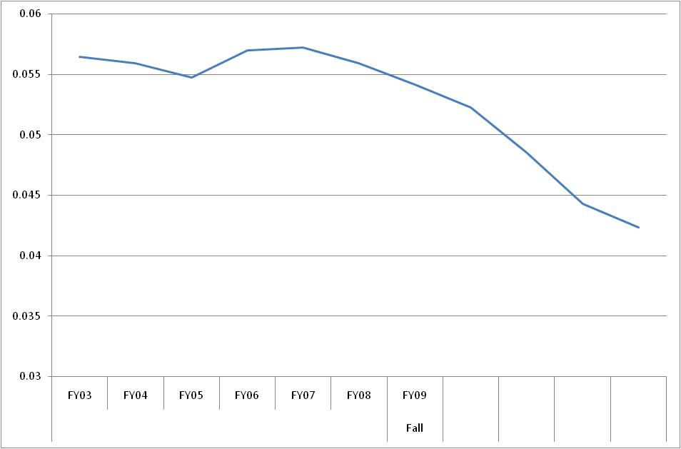
Trend Line for IUB School Share of Undergraduate Credit Hours

Slide 39
School of Education Budget: Fiscal Year 2009

Slide 40
Graduate Program Data by Student Status
Student Status | 2004-05 | 2004-05 | 2005-06 | 2006-07 | 2007-08
Applications | 1123 | 1150 | 1000 | 1009 | 939
Admissions | 544 | 645 | 544 | 507 | 535
Newly Enrolled * | 322 | 327 | 348 | 329 | 383
Graduated | 352 | 380 | 427 | 332 | 363
*Includes students who applied and were admitted any time during the previous two academic years.

Slide 41
Graduate Program Data by Degree & Student Status
Degree & Status | 2003-04 | 2004-05 | 2005-06 | 2006-07 | 2007-08
MSED applied | 567 | 607 | 554 | 564 | 522
admitted | 306 | 432 | 353 | 315 | 335
newly enrolled | 198 | 196 | 231 | 215 | 261
EdS applied | 87 | 84 | 73 | 80 | 69
admitted | 14 | 36 | 14 | 28 | 26
newly enrolled | 4 | 30 | 17 | 15 | 14
EdD applied | 32 | 61 | 32 | 16 | 30
admitted | 20 | 30 | 18 | 11 | 25
newly enrolled | 7 | 3 | 10 | 12 | 25
PhD applied | 437 | 398 | 341 | 349 | 318
admitted | 204 | 147 | 159 | 153 | 145
newly enrolled | 113 | 98 | 90 | 87 | 82

Slide 42
Graduate Program Data by Degree Awarded
Degree Awarded | 2003-04 | 2004-05 | 2005-06 | 2006-07 | 2007-08
MSED | 236 | 263 | 288 | 273 | 272
EdS | 21 | 30 | 39 | 31 | 31
EdD | 12 | 13 | 16 | 9 | 10
PhD | 83 | 74 | 84 | 58 | 80

Slide 43
Graduate Applications Received
Where are we compared to last year?
* reflects data from Dec 1st through Dec 9th
68

Slide 44
Update on IRB
As of November 25th the IRB had 58 SOE (out of about 250 ) studies pending approval (all Expedited or Exempt)
  22 Intake – Complete
  8 On Hold per PI Request
  7 Completed by Screener
  17 In Progress by Screener
  4 Reassigned to a new Screener
Process has improved but still more complex and slower than previous years
More permanent staff are being hired but allow at LEAST 4 weeks for approval

Slide 45
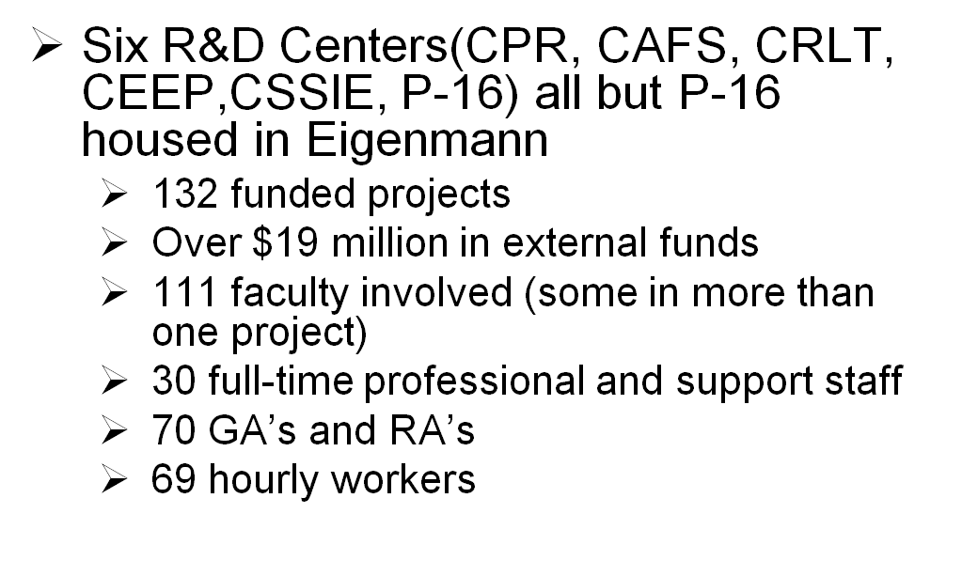
Grants and Contracts FY08

Slide 46
Grants and Contracts FY09
Goals
  Increase the Indirect Cost recovery from Grants and Contracts (FY08 yield about $1.2 million - only about 10% of Total Grants and Contract expenditures)
  Increase “Buy-out” of faculty time during the academic year (FY08 only about $0.5 million)
  Dean’s office and Center Directors are discussing various ideas to increase both of these.

Slide 47
Matching the Promise Campaign

Slide 48
Campaign Summary
Timeline: July 1, 2003 − June 30, 2010
SoE Goal→ $10,000,000
Total Raised as of 12/09/08 → $9,906,00
% of Goal→ 99%

Slide 49
Analysis of All Campaign Gifts
Current Gifts = $4.4 M (44%)
Estate Gifts = $ 5.5 M (56%)
Total = $9.9M

Slide 50
Gift Ranges ($9.9 M)
<$25,000 → 31,000+ gifts = $2.4M
≥ $25,000 → 39 gifts = $7.5M

Slide 51
Analysis of Gifts ≥ $25,000
Number of Gifts → 39
Average Gift → $200,000
Avg Age of Donors → 73

Slide 52
Gifts >= $25,000 by Designation
 | UG Scholarship | Grad Fellowship | Special Projects | Unrestricted
CEP |  | 1 | 3
C&I | 4 | 2
ELPS |  | 3 | 1
IST |  | 3
LE |  | 2
TE | 14
T to T |  | 2
GSO |  |  |  | 1
SoE Gen’rl |  |  | 1 | 2
TOTAL | 19 | 13 | 5 | 3

Slide 53
Scholarship/Fellowship Gifts Eligible for University Match
Total Gift receipts qualifying for match - $2.7M
Designation of gifts qualifying for match - 8 scholarships and 7 fellowships
Expected annual dollars as a result of the match (in perpetuity) - $117,750

Slide 54
National Comparison (includes non-governmental grants)
Fundraising = $9.9 M
Non-governmental grants = $18.3 M
SoE Total to Date = $28.2M

Slide 55
NCATE UPDATE
Faculty Meeting
December 12, 2008
Notes:
55

Slide 56
OVERVIEW
Program Reviews
Pre-requisite to NCATE Visit
Institutional Report
Complementary Requirements
Spring 2010 Visit
Notes:
56

Slide 57
PROGRAM REVIEWS
Bloomington
- 21 programs submitted 07-08
- 9 state reviews; 5 approved
- 12 professional assoc. reviews; 6 approved, 2 under review
- 8 approved with conditions; to be addressed in 2009
IUPUI/IUPUC
- 12 programs submitted 07-08
- 2 state reviews; approved with conditions
- 10 professional assoc. reviews (Sept. 2008)
results will be posted end of year
Notes:
Program review process – SPA more informative and beneficial to continuous improvement
Trends in issues to address:
- need for alignment of assessments and/or rubrics to specific professional standards
- development or refinement of assessments measuring candidate impact on student learning
- presentation of student assessment data across rubric indicators and possible scores
57

Slide 58
INSTITUTIONAL REPORT
STANDARDS
ONE Candidate Knowledge, Skills and Dispositions
TWO Assessment System/Unit Evaluation
THREE Field Experiences and Clinical Practice
FOUR Diversity
FIVE Faculty Qualifications, Performance, Development
SIX Unit Governance and Resources
Notes:
Standard One No information required IF programs have been approved through a program review process. This section will include information about a few undergraduate license addition programs and the education advanced programs.
Standard Two Information re: our UAS; great deal of work has been done on the advanced UAS this semester
Standard Four Includes information not only re: curriculum, but also candidates experience with diverse faculty, diverse peers and diverse students in schools
58

Slide 59
INSTITUTIONAL REPORT
REQUIRED DATA
Education Faculty and Graduate Assistants
Programs and Review Status (Initial/Advanced)
Praxis II Data (Initial and Other School Professionals)
Unit Assessment System: Transition Point Assessments
  (Initial/Advanced)
Field Experiences/Clinical Practice by Program
Faculty Demographics
Candidate Demographics
Clinical Practice Sites Demographics
Faculty Qualification Summary
Notes:
59

Slide 60
INSTITUTIONAL REPORT
FACULTY MANAGEMENT
Faculty Accreditation Leadership Committee
Writing Teams for each Standard
Plan to have Standard Drafts prepared by end of spring 2009 semester
Notes:
60

Slide 61
COMPLEMENTARY
REQUIREMENTS
Improved Web Presence
Faculty Profiles on Web
Work on Program Assessment Rubrics
Notes:
NCATE reviewers will rely on Web for initial preparation for the visit. Presence needs to be clear and current. A part of that is inclusion of faculty profiles
Identification of rubric software is ongoing, given lessons learned from professional association program reviews. Plan to pilot use of irubric this spring. More long term discussions/strategies will be conducted with On Course.
61

